Slide 1


Lecture 7
DLI
Properties of Expectation
期望的性质

Slide 2
DLI
Outline
Expectation of Sums of Random Variables 随机变量和的期望
Moments of the Number of Events that Occur 矩
Covariance, Variance of Sums, and Variables Correlations 协方差、和的方差及相关系数
Moment Generating Functions 矩生成函数

Slide 3
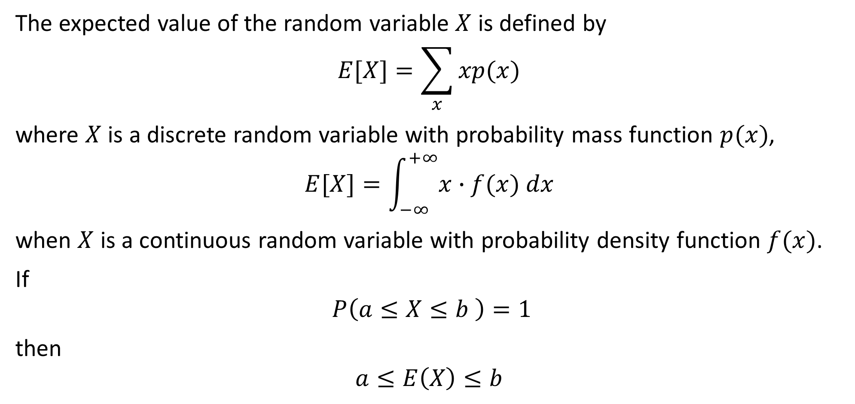
DLI
The expected value of the random variable $X$ is defined by
$$E[X]=\sum_{x}{xp(x) }$$
where $X$ is a discrete random variable with probability mass function $p(x)$,
$$E[X]=\int_{−∞}^{+∞}{x∙f(x) dx }$$
when $X$ is a continuous random variable with probability density function $f(x)$.
If
$$P\left(a≤X≤b \right)=1$$
then
$$a≤E\left(X\right)≤b$$

Slide 4
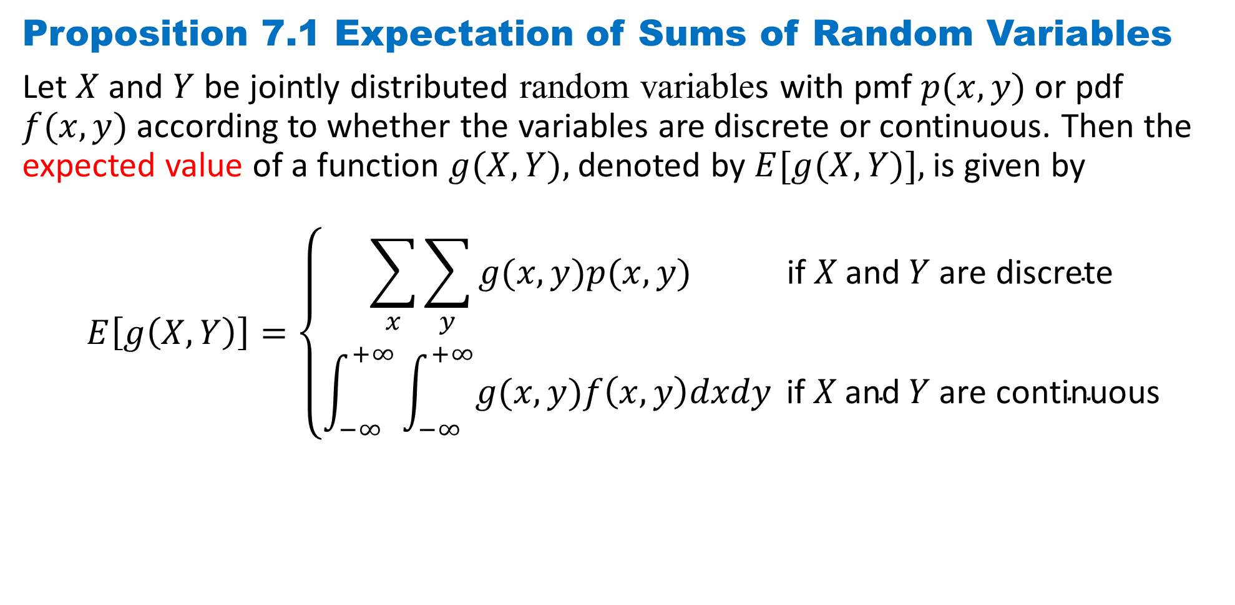
DLI
Proposition 7.1 Expectation of Sums of Random Variables
Let $X$ and $Y$ be jointly distributed random variables with pmf $p(x, y)$or pdf $f(x, y)$according to whether the variables are discrete or continuous. Then the expected value of a function $g(X, Y),$denoted by $E[g(X, Y)],$is given by
$$E\left[g\left(X, Y\right)\right]=\left\{\begin{aligned}\sum_{x}{\sum_{y}{g(x, y)p(x, y)} } \text{if} X \text{and} Y \text{are} \text{discrete} \\ \int_{−∞}^{+∞}{\int_{−∞}^{+∞}{g(x, y)f\left(x, y\right)dxdy}} \text{if} X \text{and} Y \text{are} \text{continuous}\end{aligned}\right.$$

Slide 5
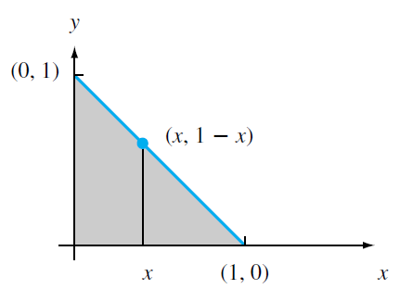
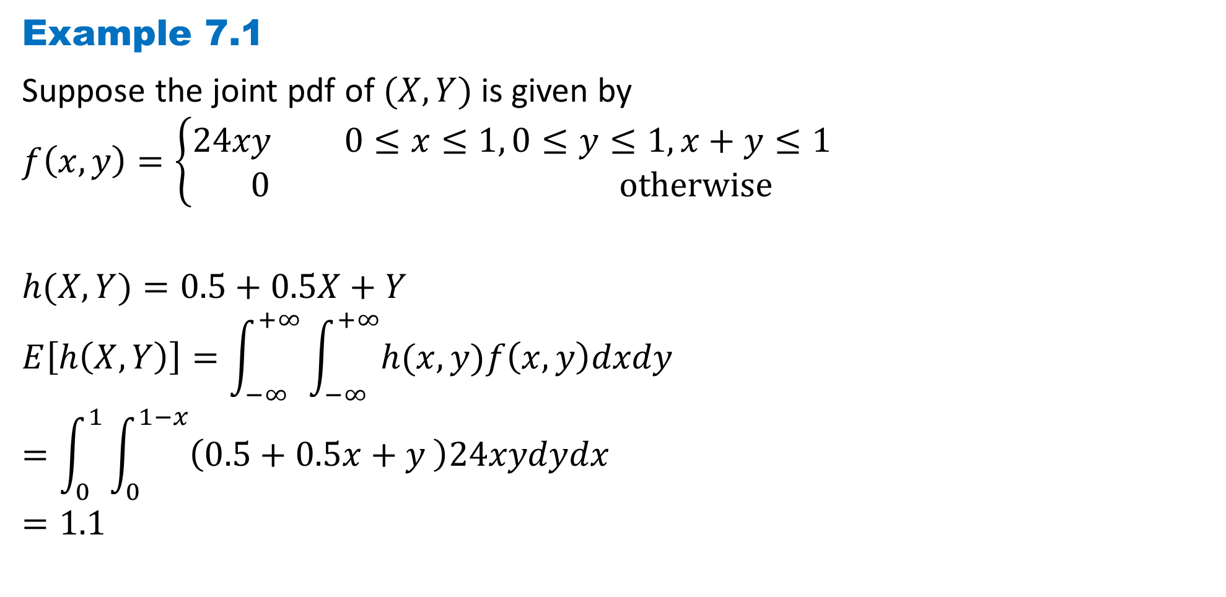
DLI
Example 7.1
Suppose the joint pdf of $(X, Y)$is given by
$$f\left(x,y\right)=\left\{\begin{aligned}24xy 0≤x≤1, 0≤y≤1, x+y≤1 \\ 0 otherwise\end{aligned}\right.$$
$$h(X, Y)=0.5+0.5X+Y$$
$$E\left[h\left(X, Y\right)\right]=\int_{−∞}^{+∞}{\int_{−∞}^{+∞}{h(x, y)f\left(x, y\right)dxdy}}$$
$$=\int_{0}^{1}{\int_{0}^{1−x}{\left(0.5+0.5x+y \right)24xydydx}}$$
$$=1.1$$

Slide 6
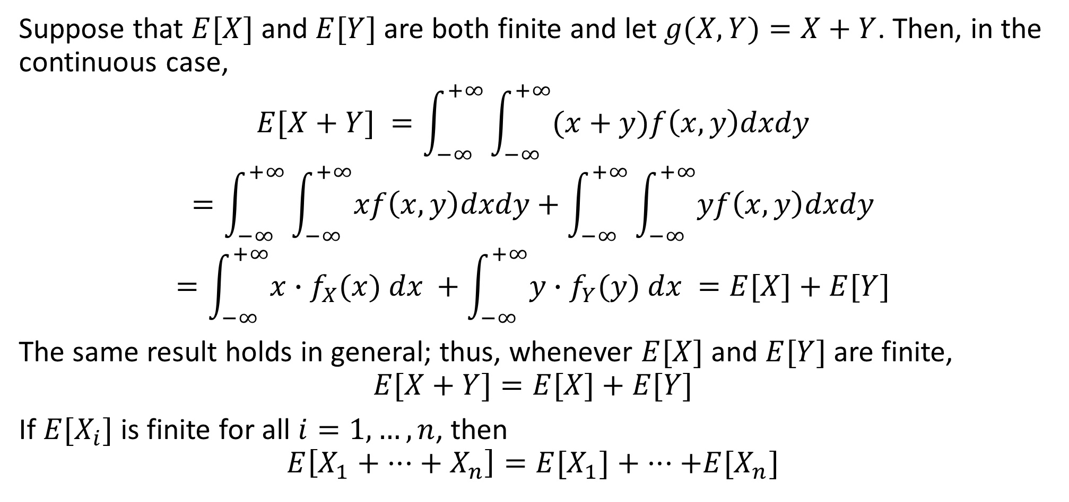
DLI
Suppose that $E[X]$ and $E[Y]$ are both finite and let $g(X, Y)=X+Y$. Then, in the continuous case,
$$E[X+Y] =\int_{−∞}^{+∞}{\int_{−∞}^{+∞}{(x+y)f\left(x, y\right)dxdy}}$$
$$=\int_{−∞}^{+∞}{\int_{−∞}^{+∞}{xf\left(x, y\right)dxdy}}+\int_{−∞}^{+∞}{\int_{−∞}^{+∞}{yf\left(x, y\right)dxdy}}$$
$$=\int_{−∞}^{+∞}{x∙f_{X}(x) dx }+\int_{−∞}^{+∞}{y∙f_{Y}(y) dx }=E[X]+E[Y]$$
The same result holds in general; thus, whenever $E[X]$ and $E[Y]$ are finite,
$$E[X+Y]=E[X]+E[Y]$$
If $E[X_{i}]$ is finite for all $i=1, …, n$, then
$$E\left[X_{1}+ ···+ X_{n}\right]=E[X_{1}]+ ···+E[X_{n}]$$

Slide 7
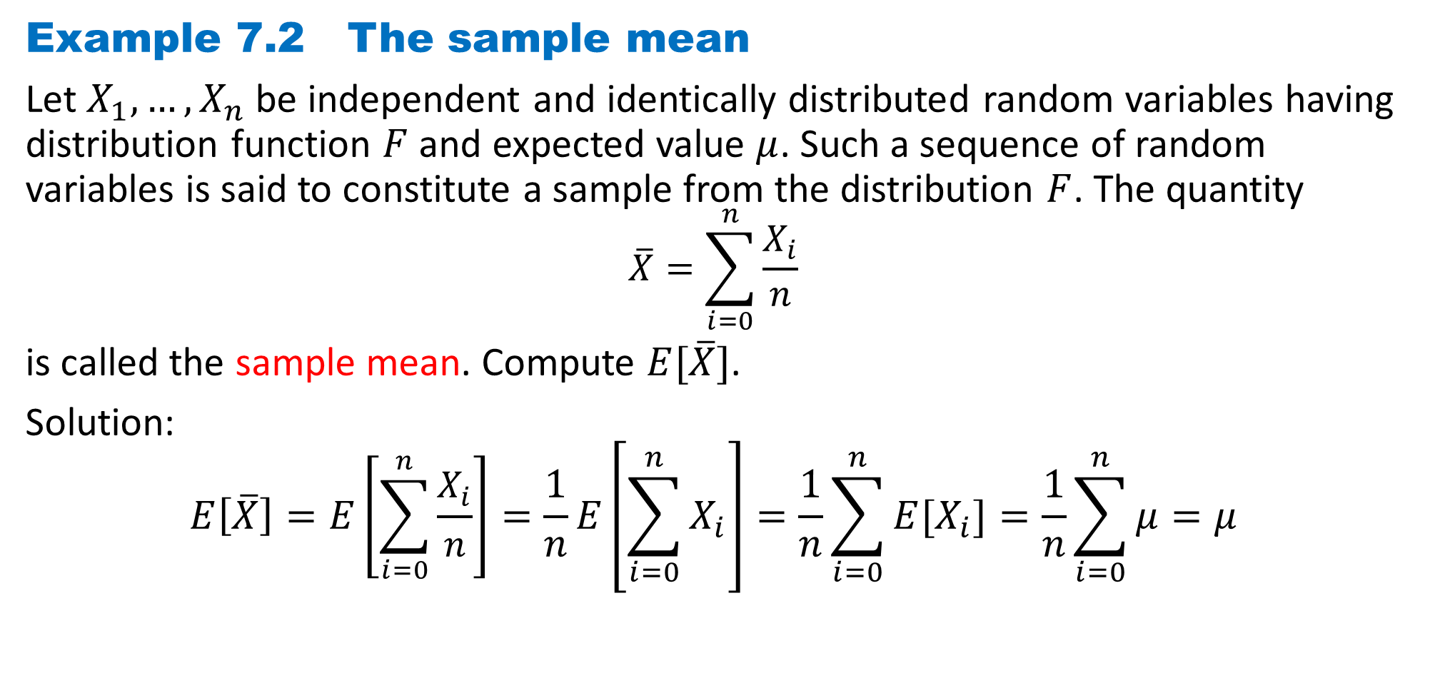
DLI
Example 7.2 The sample mean
Let $X_{1}, …,X_{n}$be independent and identically distributed random variables having distribution function $F$ and expected value $μ$. Such a sequence of random variables is said to constitute a sample from the distribution $F$. The quantity
$$\overline{X}=\sum_{i=0}^{n}{\frac{X_{i}}{n}}$$
is called the sample mean. Compute $E[\overline{X}]$.
Solution:
$$E\left[\overline{X}\right]=E\left[\sum_{i=0}^{n}{\frac{X_{i}}{n}}\right]=\frac{1}{n}E\left[\sum_{i=0}^{n}{X_{i}}\right]=\frac{1}{n}\sum_{i=0}^{n}{{E[X}_{i}]}=\frac{1}{n}\sum_{i=0}^{n}{μ}=μ$$

Slide 8
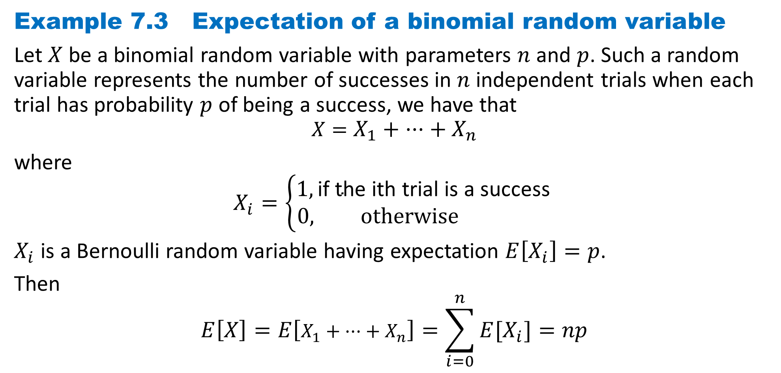
DLI
Example 7.3 Expectation of a binomial random variable
Let $X$ be a binomial random variable with parameters $n$ and $p$. Such a random variable represents the number of successes in $n$ independent trials when each trial has probability $p$ of being a success, we have that
$$X=X_{1}+ ···+ X_{n}$$
where
$$X_{i}=\left\{\begin{aligned}1,\text{if} \text{the} \text{ith} \text{trial} \text{is} \text{a} \text{success} \\ 0, otherwise \end{aligned}\right.$$
$X_{i}$ is a Bernoulli random variable having expectation $E\left[X_{i}\right]=p$.
Then
$$E\left[X\right]=E\left[X_{1}+ ···+ X_{n}\right]=\sum_{i=0}^{n}{{E[X}_{i}]}=np$$

Slide 9
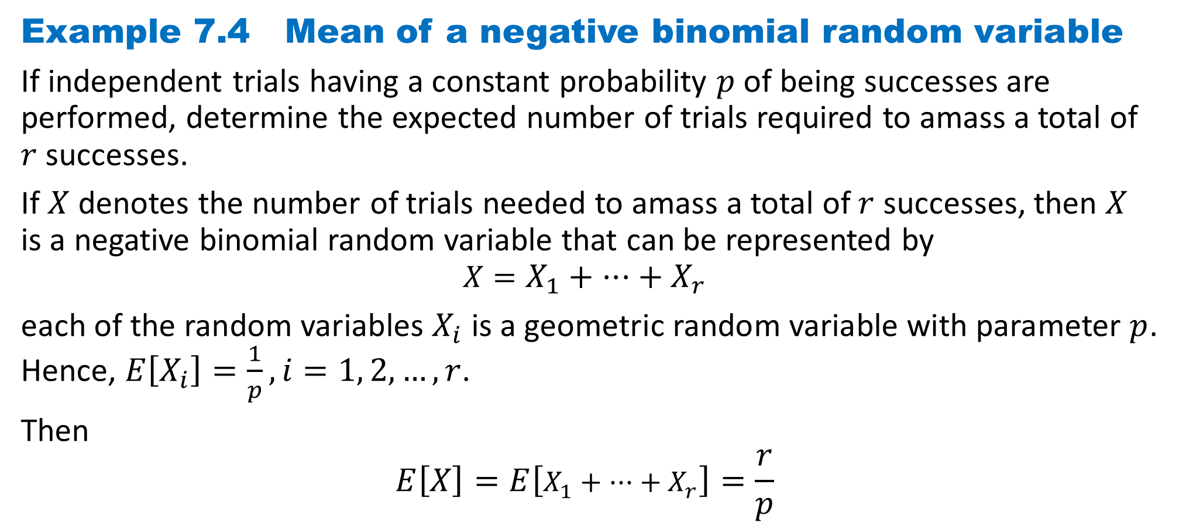
DLI
Example 7.4 Mean of a negative binomial random variable
If independent trials having a constant probability $p$ of being successes are performed, determine the expected number of trials required to amass a total of $r$ successes.
If $X$ denotes the number of trials needed to amass a total of $r$ successes, then $X$ is a negative binomial random variable that can be represented by
$$X=X_{1}+ ···+ X_{r}$$
each of the random variables $X_{i}$ is a geometric random variable with parameter $p$. Hence, $E\left[X_{i}\right]=\frac{1}{p},i=1, 2, …, r$.
Then
$$E\left[X\right]=E\left[X_{1}+ ···+ X_{r}\right]=\frac{r}{p}$$

Slide 10
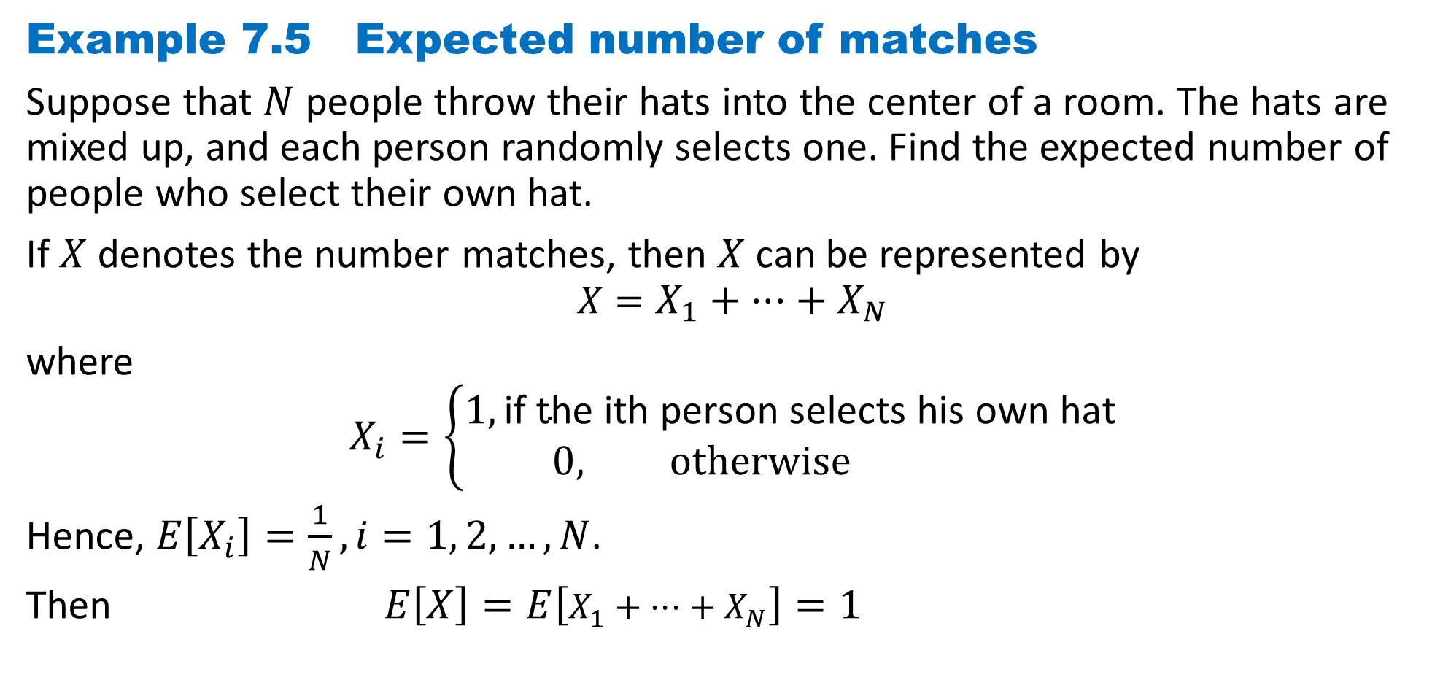
DLI
Example 7.5 Expected number of matches
Suppose that $N$ people throw their hats into the center of a room. The hats are mixed up, and each person randomly selects one. Find the expected number of people who select their own hat.
If $X$ denotes the number matches, then $X$ can be represented by
$$X=X_{1}+ ···+ X_{N}$$
where
$$X_{i}=\left\{\begin{aligned}1,\text{if} \text{the} \text{ith} \text{person} \text{selects} \text{his} \text{own} \text{hat} \\ 0, otherwise \end{aligned}\right.$$
Hence, $E\left[X_{i}\right]=\frac{1}{N},i=1, 2, …, N$.
Then $E\left[X\right]=E\left[X_{1}+ ···+ X_{N}\right]=1$

Slide 11
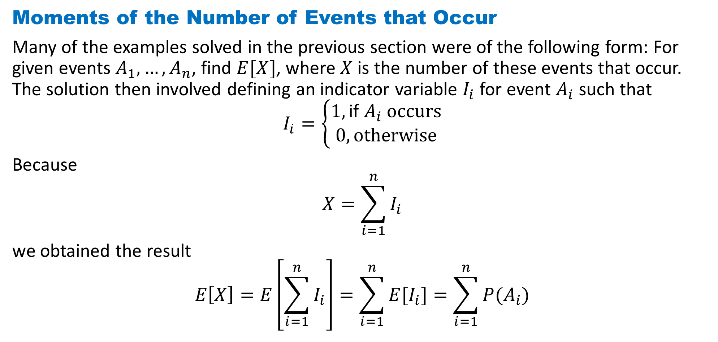
DLI
Moments of the Number of Events that Occur
Many of the examples solved in the previous section were of the following form: For given events $A_{1}, …, A_{n}$, find $E[X]$, where $X$ is the number of these events that occur. The solution then involved defining an indicator variable $I_{i}$ for event $A_{i}$such that
$$I_{i}=\left\{\begin{aligned}1,\text{if} A_{i} \text{occurs} \\ 0, otherwise\end{aligned}\right.$$
Because
$$X=\sum_{i=1}^{n}{I_{i}}$$
we obtained the result
$$E\left[X\right]=E\left[\sum_{i=1}^{n}{I_{i}}\right]=\sum_{i=1}^{n}{{E[I}_{i}]}=\sum_{i=1}^{n}{{P(A}_{i})}$$

Slide 12
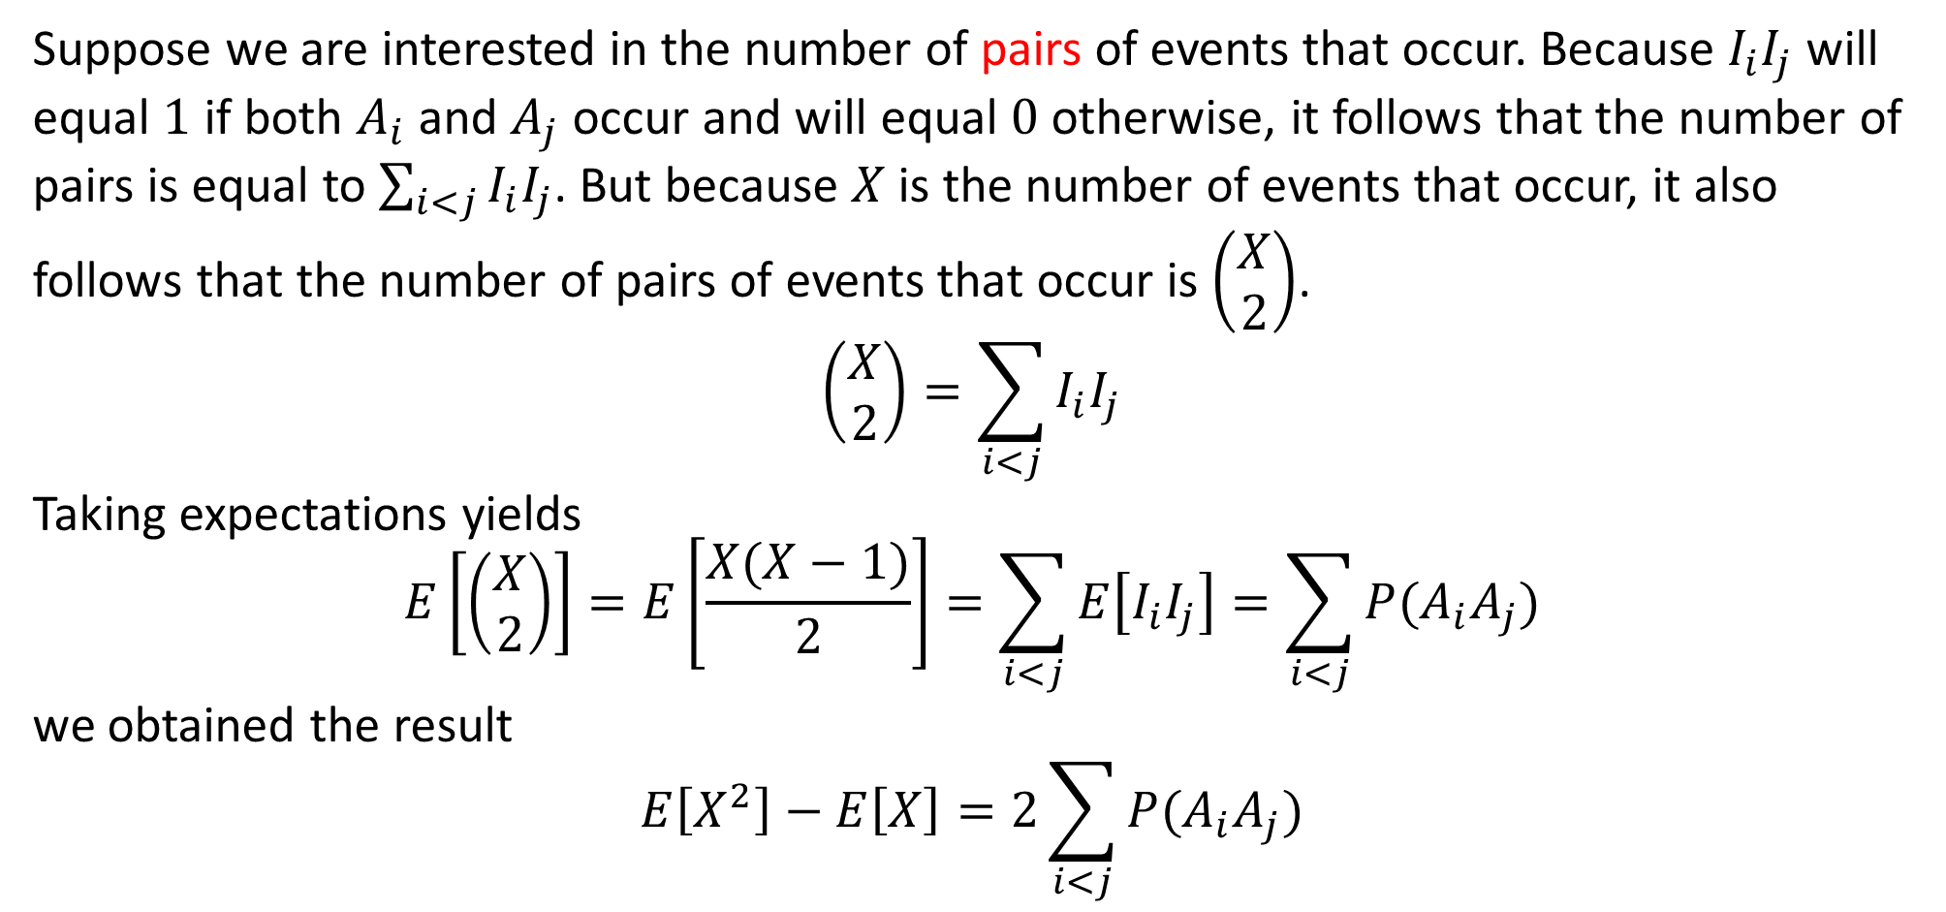
DLI
Suppose we are interested in the number of pairs of events that occur. Because $I_{i}I_{j}$will equal $1$ if both $A_{i}$ and $A_{j}$ occur and will equal $0$ otherwise, it follows that the number of pairs is equal to $\sum_{i<j}{I_{i}I_{j}}$. But because $X$ is the number of events that occur, it also follows that the number of pairs of events that occur is $\left(\begin{matrix}X \\ 2\end{matrix}\right)$.
$$\left(\begin{matrix}X \\ 2\end{matrix}\right)=\sum_{i<j}{I_{i}I_{j}}$$
Taking expectations yields
$$E\left[\left(\begin{matrix}X \\ 2\end{matrix}\right)\right]=E\left[\frac{X(X−1)}{2}\right]=\sum_{i<j}{E\left[I_{i}I_{j}\right]}=\sum_{i<j}{P(A_{i}A_{j})}$$
we obtained the result
$$E\left[X^{2}\right]−E\left[X\right]=2\sum_{i<j}{P(A_{i}A_{j})}$$

Slide 13
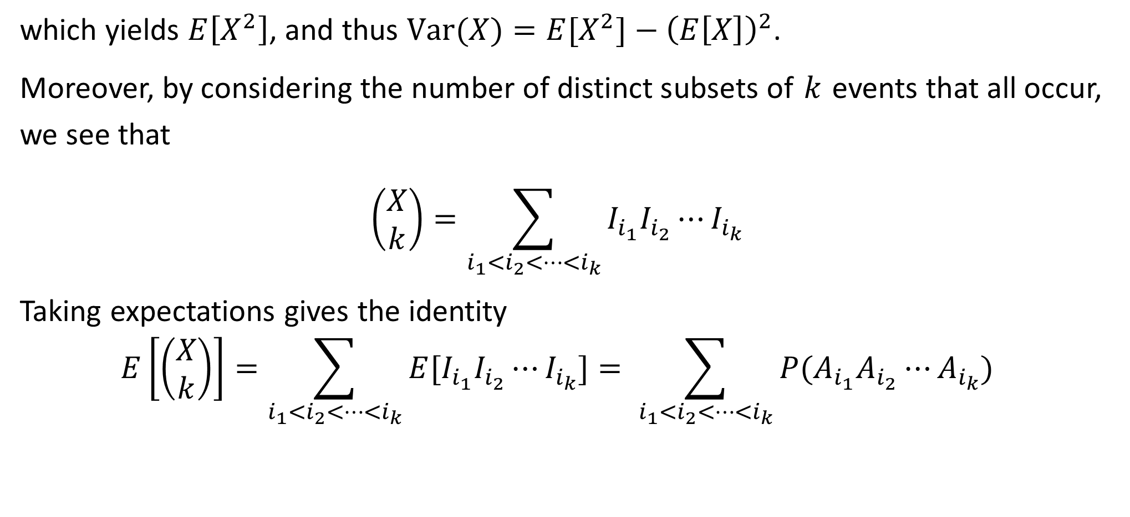
DLI
which yields $E\left[X^{2}\right]$, and thus $Var(X)=E[X^{2}]−{\left(E\left[X\right]\right)}^{2}$.
Moreover, by considering the number of distinct subsets of $k$ events that all occur, we see that
$$\left(\begin{matrix}X \\ k\end{matrix}\right)=\sum_{i_{1}<i_{2}<…<i_{k}}{I_{i_{1}}I_{i_{2}}⋯I_{i_{k}}}$$
Taking expectations gives the identity
$$E\left[\left(\begin{matrix}X \\ k\end{matrix}\right)\right]=\sum_{i_{1}<i_{2}<…<i_{k}}{E[I_{i_{1}}I_{i_{2}}⋯I_{i_{k}}}]= \sum_{i_{1}<i_{2}<…<i_{k}}{P(A_{i_{1}}A_{i_{2}}⋯A_{i_{k}})}$$

Slide 14
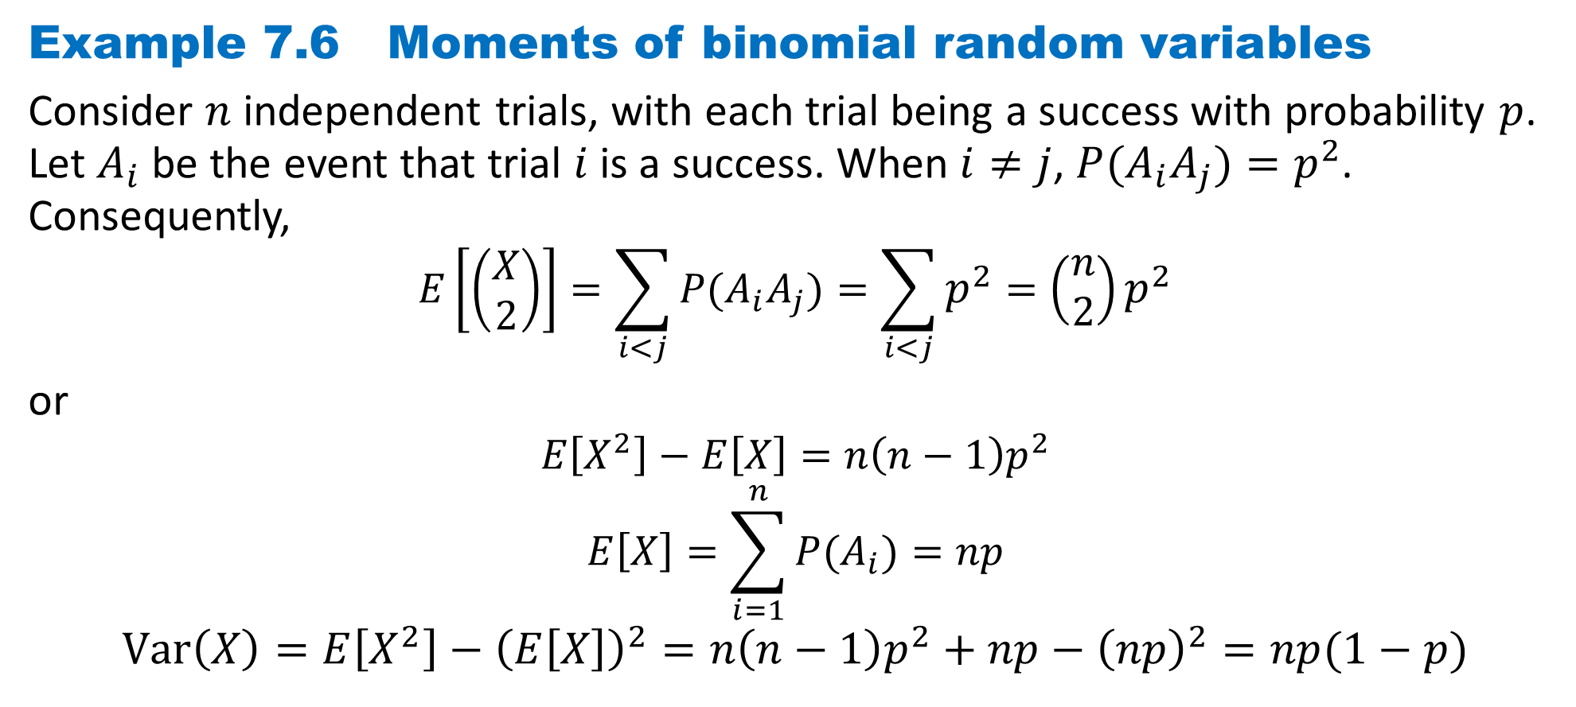
DLI
Example 7.6 Moments of binomial random variables
Consider $n$ independent trials, with each trial being a success with probability $p$. Let $A_{i}$ be the event that trial $i$ is a success. When $i≠j$, $P(A_{i}A_{j})=p^{2}$. Consequently,
$$E\left[\left(\begin{matrix}X \\ 2\end{matrix}\right)\right]=\sum_{i<j}{P(A_{i}A_{j})}=\sum_{i<j}{p^{2}}=\left(\begin{matrix}n \\ 2\end{matrix}\right)p^{2}$$
or
$$E\left[X^{2}\right]−E\left[X\right]=n\left(n−1\right)p^{2}$$
$$E\left[X\right]=\sum_{i=1}^{n}{{P(A}_{i})}=np$$
$$Var\left(X\right)=E\left[X^{2}\right]−{\left(E\left[X\right]\right)}^{2}=n\left(n−1\right)p^{2}+np−{\left(np\right)}^{2}=np(1−p)$$

Slide 15
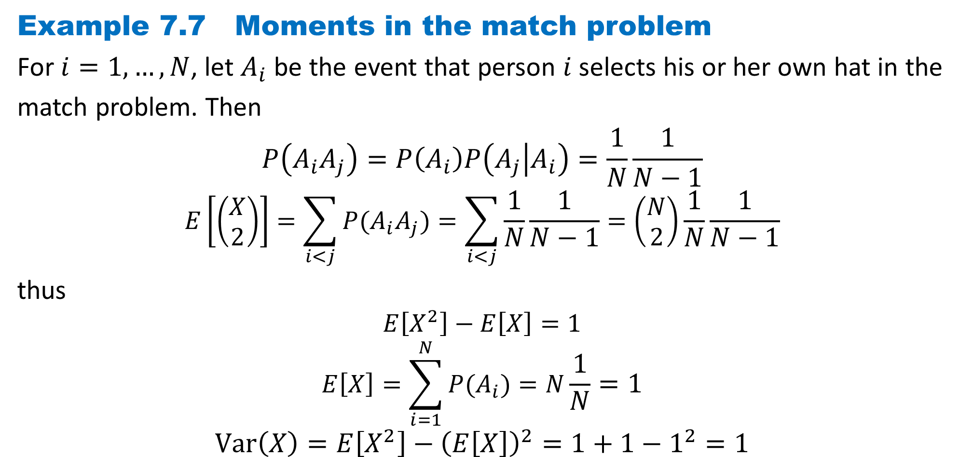
DLI
Example 7.7 Moments in the match problem
For $i=1,…, N$, let $A_{i}$ be the event that person $i$ selects his or her own hat in the
match problem. Then
$$P\left(A_{i}A_{j}\right)=P\left(A_{i}\right)P\left(A_{j} | A_{i}\right)=\frac{1}{N}\frac{1}{N−1}$$
$$E\left[\left(\begin{matrix}X \\ 2\end{matrix}\right)\right]=\sum_{i<j}{P(A_{i}A_{j})}=\sum_{i<j}{\frac{1}{N}\frac{1}{N−1}}=\left(\begin{matrix}N \\ 2\end{matrix}\right)\frac{1}{N}\frac{1}{N−1}$$
thus
$$E\left[X^{2}\right]−E\left[X\right]=1$$
$$E\left[X\right]=\sum_{i=1}^{N}{{P(A}_{i})}=N\frac{1}{N}=1$$
$$Var\left(X\right)=E\left[X^{2}\right]−{\left(E\left[X\right]\right)}^{2}=1+1−1^{2}=1$$

Slide 16
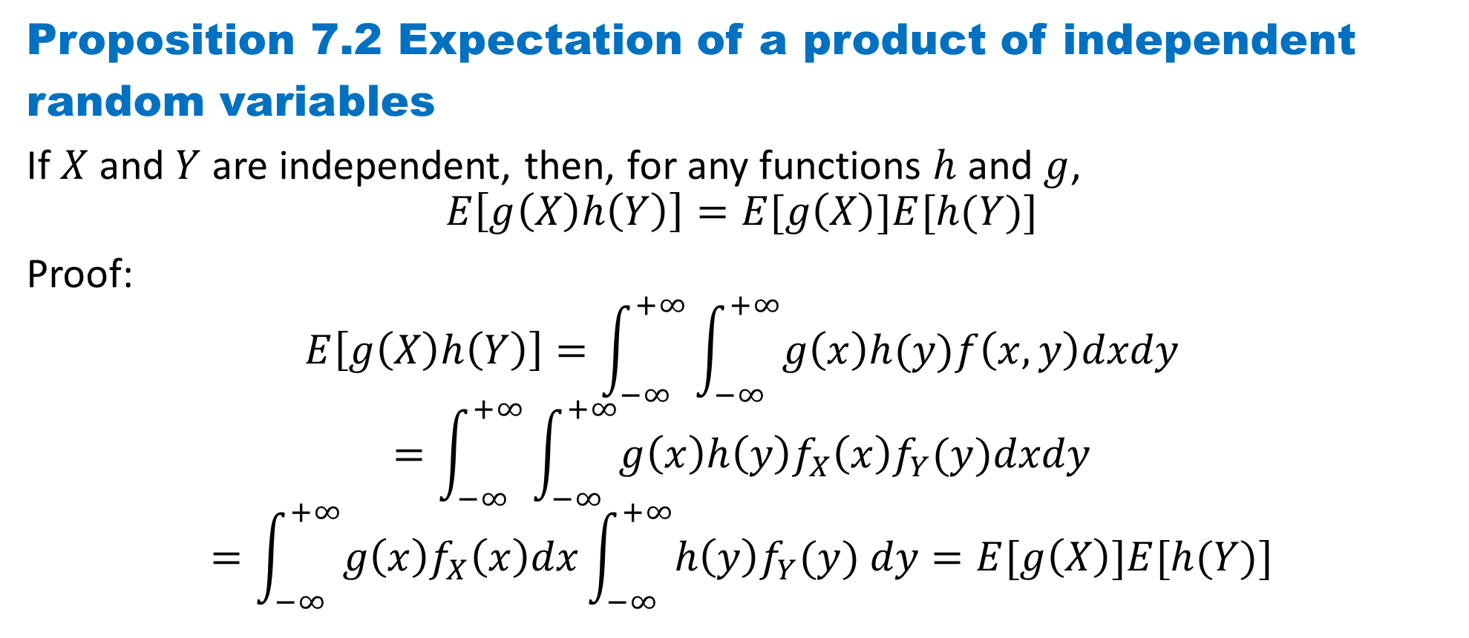
DLI
Proposition 7.2 Expectation of a product of independent
random variables
If $X$and $Y$ are independent, then, for any functions $h$ and $g$,
$$E\left[g\left(X\right)h\left(Y\right)\right]=E[g\left(X\right)]E[h(Y)]$$
Proof:
$$E\left[g\left(X\right)h\left(Y\right)\right]=\int_{−∞}^{+∞}{\int_{−∞}^{+∞}{g\left(x\right)h(y)f\left(x, y\right)dxdy}}$$
$$=\int_{−∞}^{+∞}{\int_{−∞}^{+∞}{g\left(x\right)h\left(y\right)f_{X}\left(x\right)f_{Y}(y)dxdy}}$$
$$=\int_{−∞}^{+∞}{g\left(x\right)f_{X}\left(x\right)dx}\int_{−∞}^{+∞}{h\left(y\right)f_{Y}(y) dy}=E[g\left(X\right)]E[h(Y)]$$

Slide 17
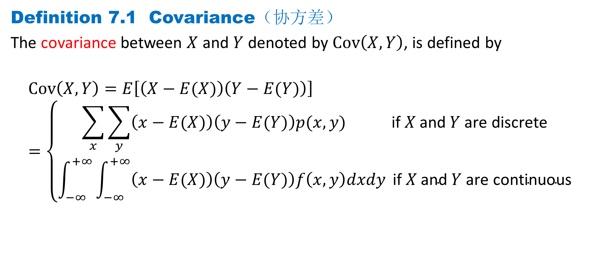
DLI
Definition 7.1 Covariance（协方差）
The covariance between $X$ and $Y$ denoted by $Cov\left(X, Y\right)$, is defined by
$$Cov\left(X, Y\right)=E\left[\left(X−E(X)\right)\left(Y−E(Y)\right)\right]=\left\{\begin{aligned}\sum_{x}{\sum_{y}{\left(x−E(X)\right)\left(y−E(Y)\right)p(x, y)} } \text{i}\text{f} X \text{and} Y \text{are} \text{discrete} \\ \int_{−∞}^{+∞}{\int_{−∞}^{+∞}{\left(x−E(X)\right)\left(y−E(Y)\right)f\left(x, y\right)dxdy}} \text{if} X \text{and} Y \text{are} \text{continuous}\end{aligned}\right.$$

Slide 18
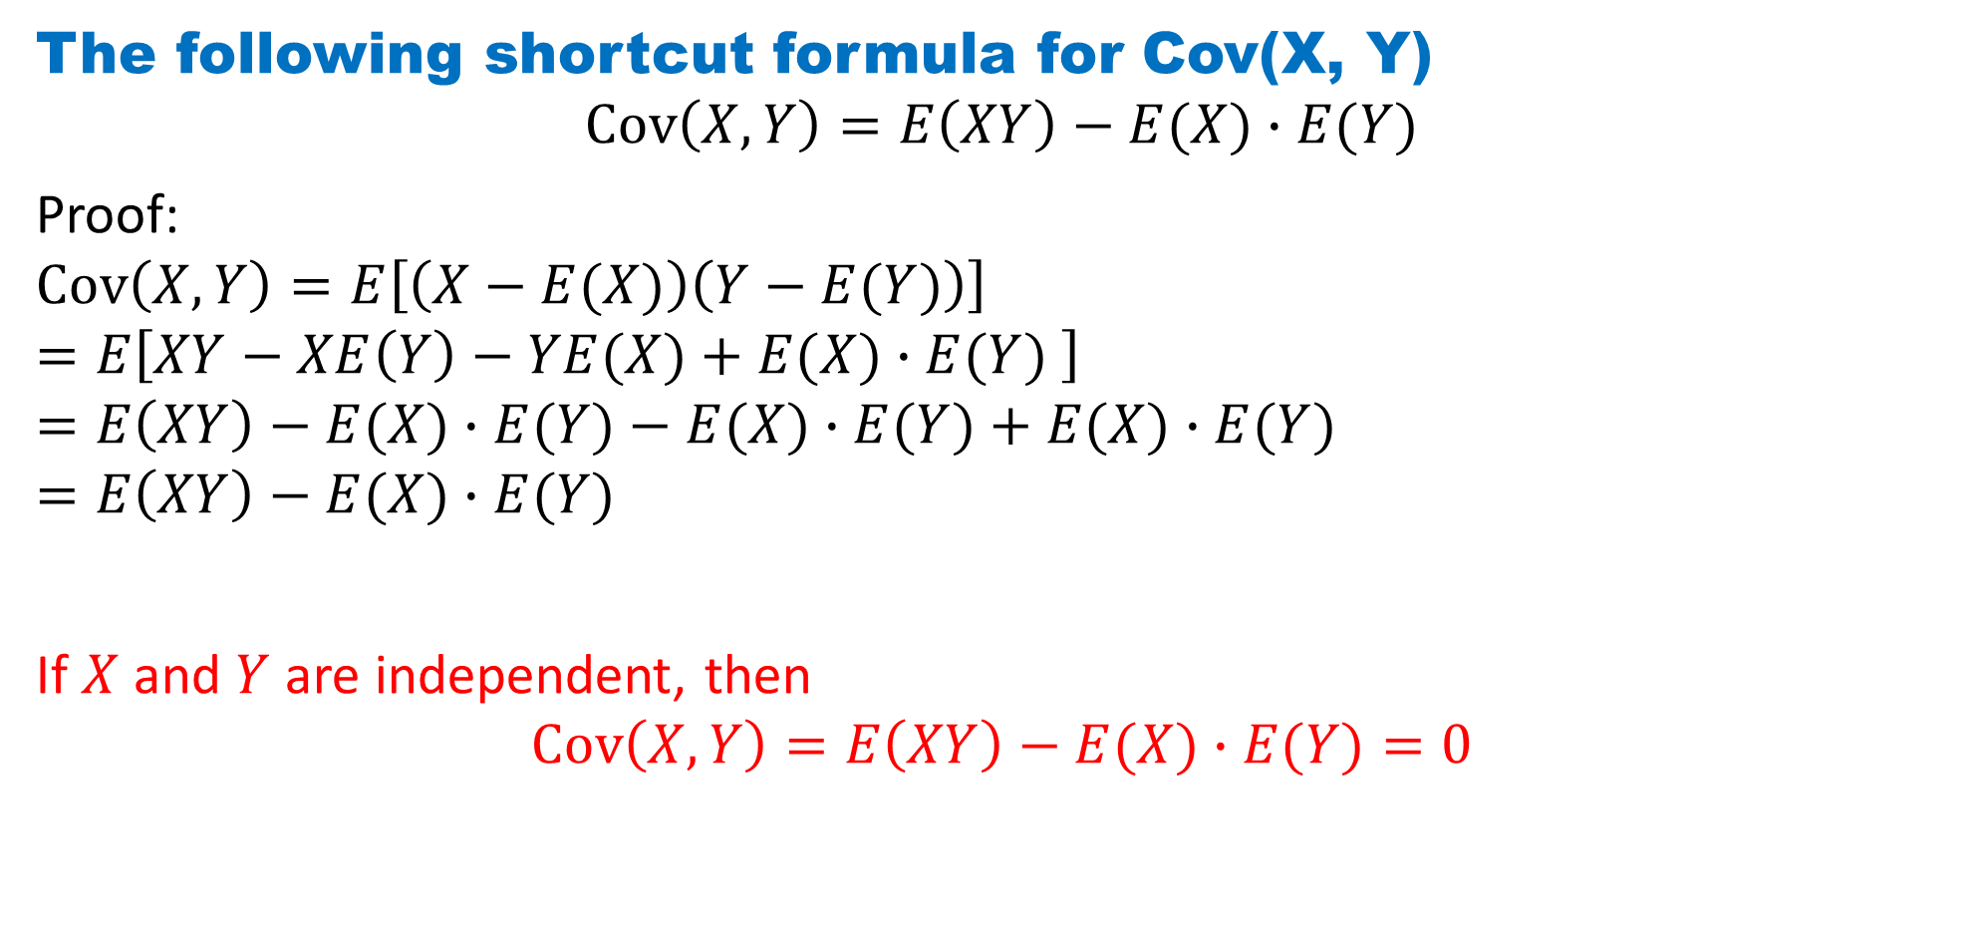
DLI
The following shortcut formula for Cov(X, Y)
$$Cov\left(X, Y\right)=E\left(XY\right)−E(X)∙E(Y)$$
Proof:
$$Cov\left(X, Y\right)=E\left[\left(X−E(X)\right)\left(Y−E(Y)\right)\right]$$
$$=E\left[XY−XE\left(Y\right)−YE(X)+E(X)∙E(Y) \right]$$
$$=E\left(XY\right)−E(X)∙E(Y)−E(X)∙E(Y)+E(X)∙E(Y)$$
$$=E\left(XY\right)−E(X)∙E(Y)$$
If $X$and $Y$ are independent, then
$$Cov\left(X, Y\right)=E\left(XY\right)−E(X)∙E(Y)=0$$

Slide 19
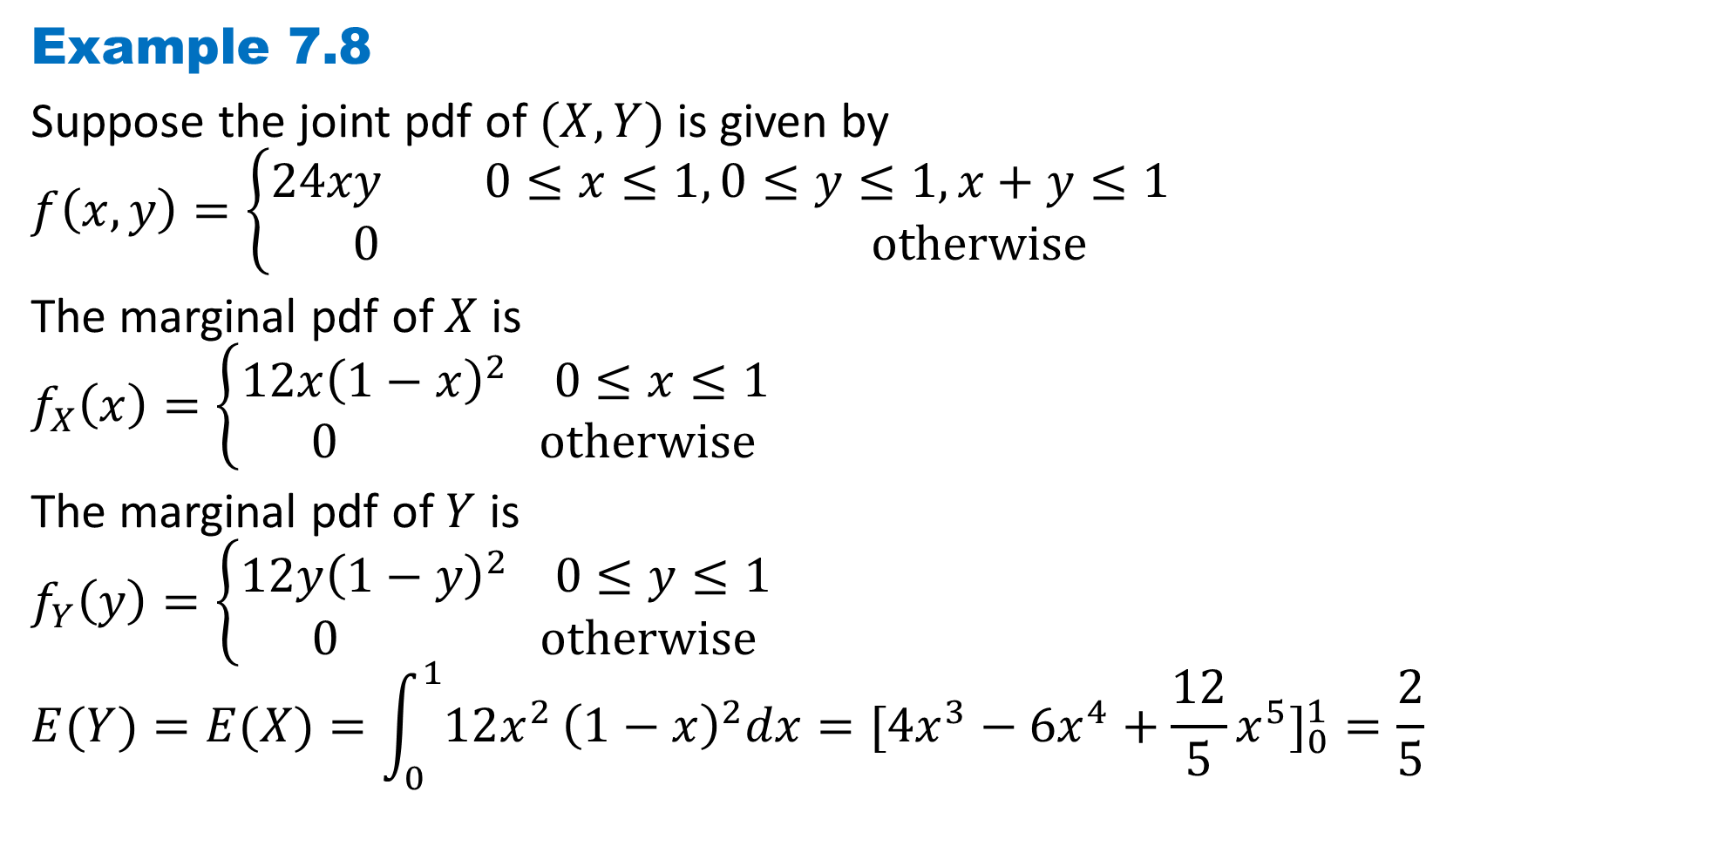
DLI
Example 7.8
Suppose the joint pdf of $(X, Y)$is given by
$$f\left(x,y\right)=\left\{\begin{aligned}24xy 0≤x≤1, 0≤y≤1, x+y≤1 \\ 0 otherwise\end{aligned}\right.$$
The marginal pdf of $X$ is
$$f_{X}\left(x\right)=\left\{\begin{aligned}12x{\left(1−x\right)}^{2} 0≤x≤1 \\ 0 otherwise\end{aligned}\right.$$
The marginal pdf of $Y$ is
$$f_{Y}\left(y\right)=\left\{\begin{aligned}12y{\left(1−y\right)}^{2} 0≤y≤1 \\ 0 otherwise\end{aligned}\right.$$
$$E(Y)=E(X)=\int_{0}^{1}{12x^{2}}{\left(1−x\right)}^{2}dx=[4x^{3}−6x^{4}+\frac{12}{5}x^{5}]_{0}^{1}=\frac{2}{5}$$

Slide 20
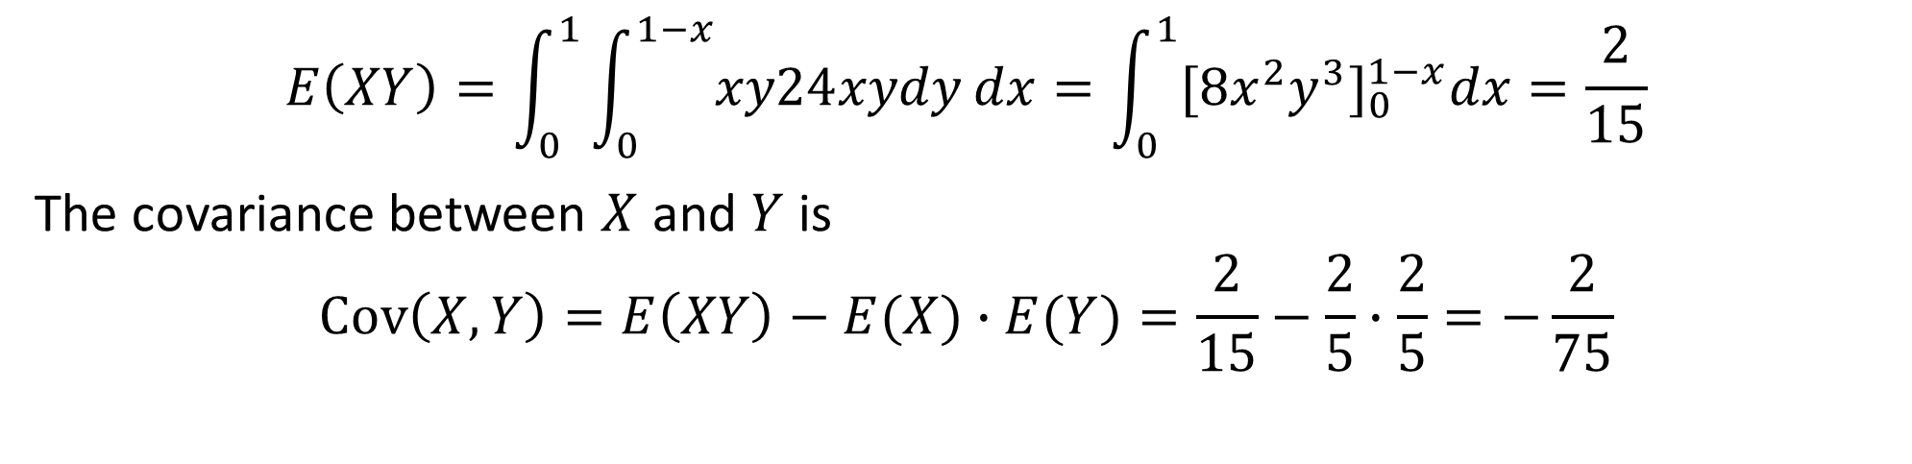
DLI
$$E\left(XY\right)=\int_{0}^{1}{\int_{0}^{1−x}{xy24xydy}dx=\int_{0}^{1}{[8x^{2}y^{3}]_{0}^{1−x}dx}}=\frac{2}{15}$$
The covariance between $X$ and $Y$ is
$$Cov\left(X, Y\right)=E\left(XY\right)−E(X)∙E(Y)=\frac{2}{15}−\frac{2}{5}∙\frac{2}{5}=−\frac{2}{75}$$

Slide 21
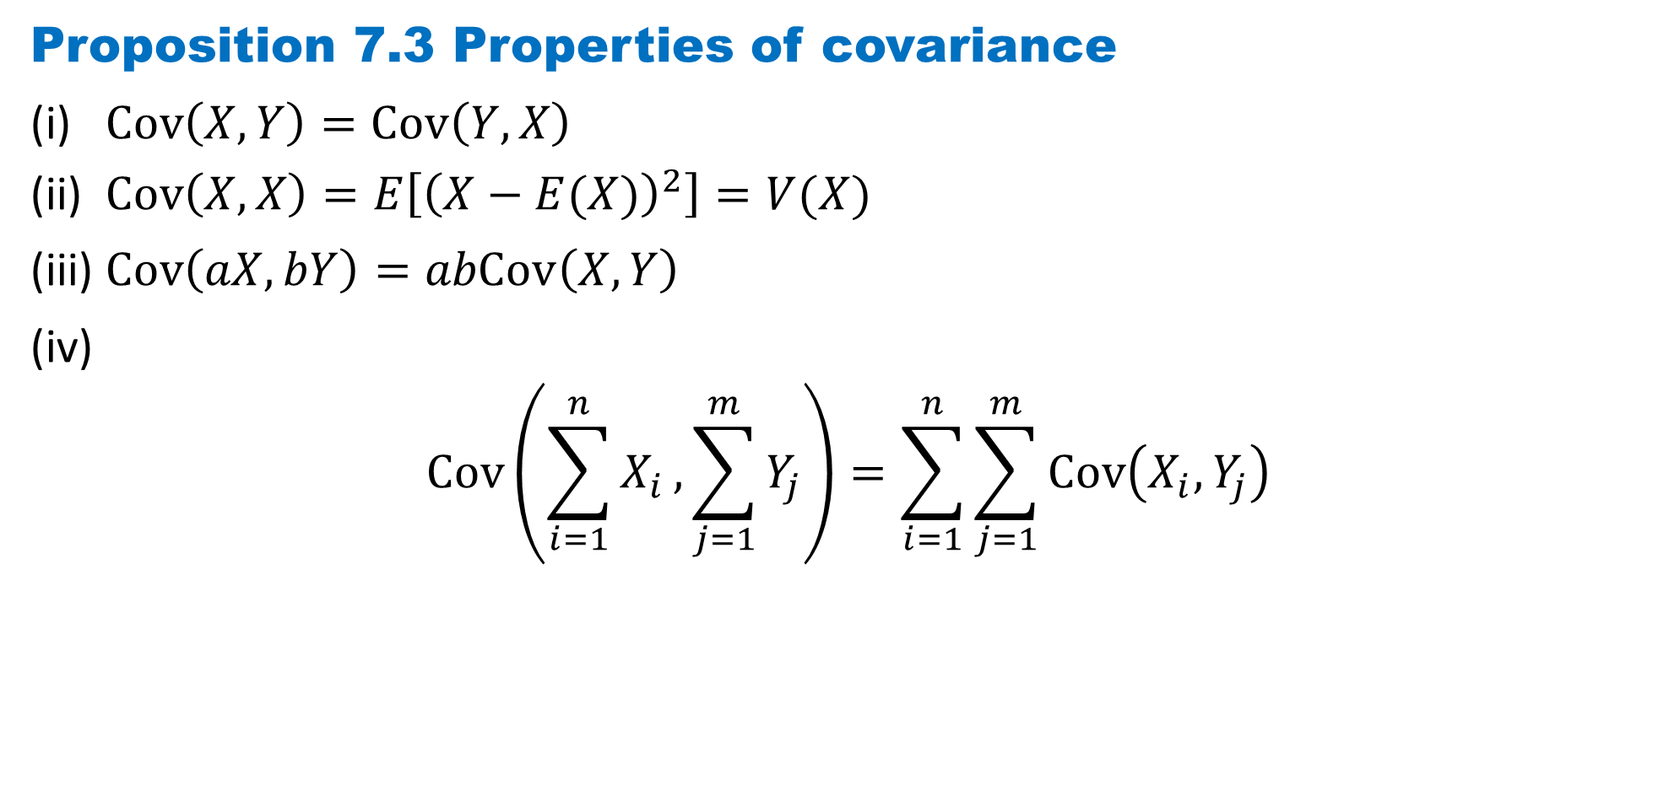
DLI
Proposition 7.3 Properties of covariance
(i) $Cov\left(X, Y\right)=Cov\left(Y, X\right)$
(ii) $Cov\left(X, X\right)=E\left[{\left(X−E(X)\right)}^{2}\right]=V(X)$
(iii) $Cov\left(aX, bY\right)=abCov\left(X, Y\right)$
(iv)
$$Cov\left(\sum_{i=1}^{n}{X_{i}},\sum_{j=1}^{m}{Y_{j}}\right)=\sum_{i=1}^{n}{\sum_{j=1}^{m}{Cov\left(X_{i}, Y_{j}\right)}}$$

Slide 22
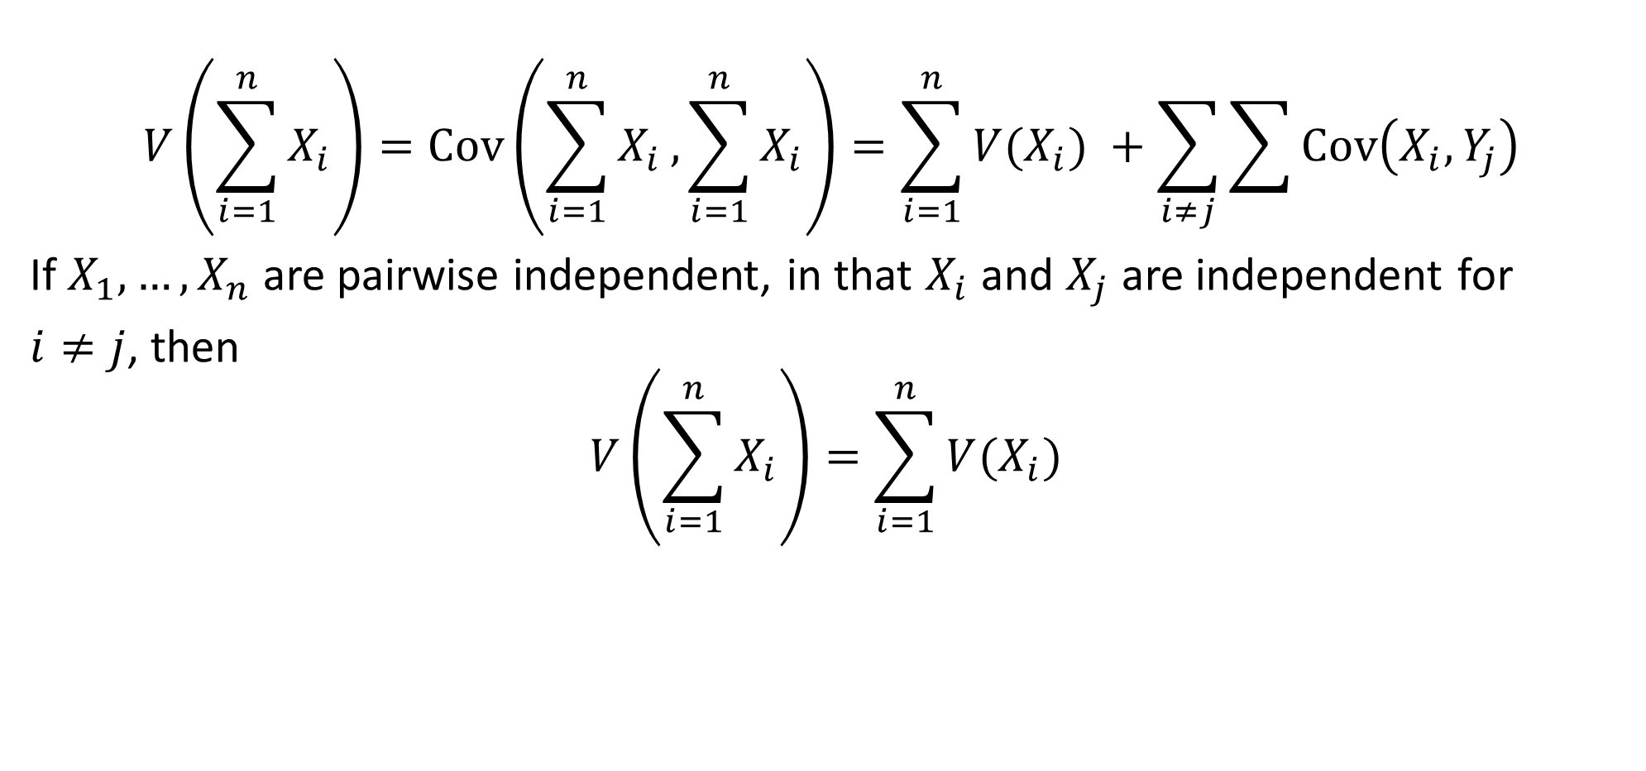
DLI
$$V\left(\sum_{i=1}^{n}{X_{i}}\right)=Cov\left(\sum_{i=1}^{n}{X_{i}},\sum_{i=1}^{n}{X_{i}}\right)=\sum_{i=1}^{n}{V(X_{i}) }+\sum_{i≠j}{\sum{Cov\left(X_{i}, Y_{j}\right)}}$$
If $X_{1}, …,X_{n}$are pairwise independent, in that $X_{i}$ and $X_{j}$ are independent for
$i≠j$, then
$$V\left(\sum_{i=1}^{n}{X_{i}}\right)=\sum_{i=1}^{n}{V(X_{i}) }$$

Slide 23
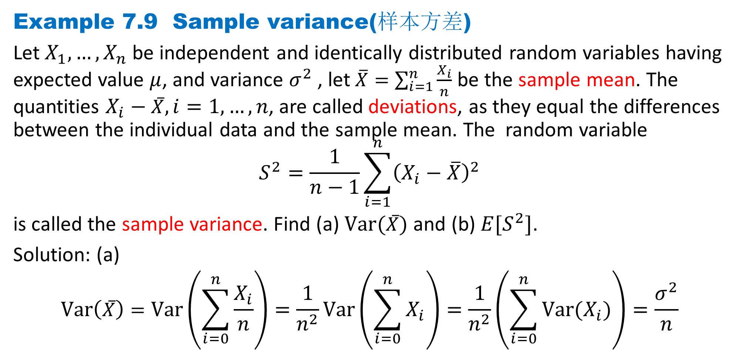
DLI
Example 7.9 Sample variance(样本方差)
Let $X_{1}, …,X_{n}$ be independent and identically distributed random variables having expected value $μ$, and variance $σ^{2}$, let $\overline{X}=\sum_{i=1}^{n}{\frac{X_{i}}{n}}$ be the sample mean. The quantities $X_{i}−\overline{X}, i=1, …, n$, are called deviations, as they equal the differences between the individual data and the sample mean. The random variable
$$S^{2}=\frac{1}{n−1}\sum_{i=1}^{n}{{\left(X_{i}−\overline{X}\right)}^{2}}$$
is called the sample variance. Find (a) $Var(\overline{X})$ and (b) $E[S^{2}]$.
Solution: (a)
$$Var\left(\overline{X}\right)=Var\left(\sum_{i=0}^{n}{\frac{X_{i}}{n}}\right)=\frac{1}{n^{2}}Var\left(\sum_{i=0}^{n}{X_{i}}\right)=\frac{1}{n^{2}}\left(\sum_{i=0}^{n}{{Var(X}_{i})}\right)=\frac{σ^{2}}{n}$$

Slide 24
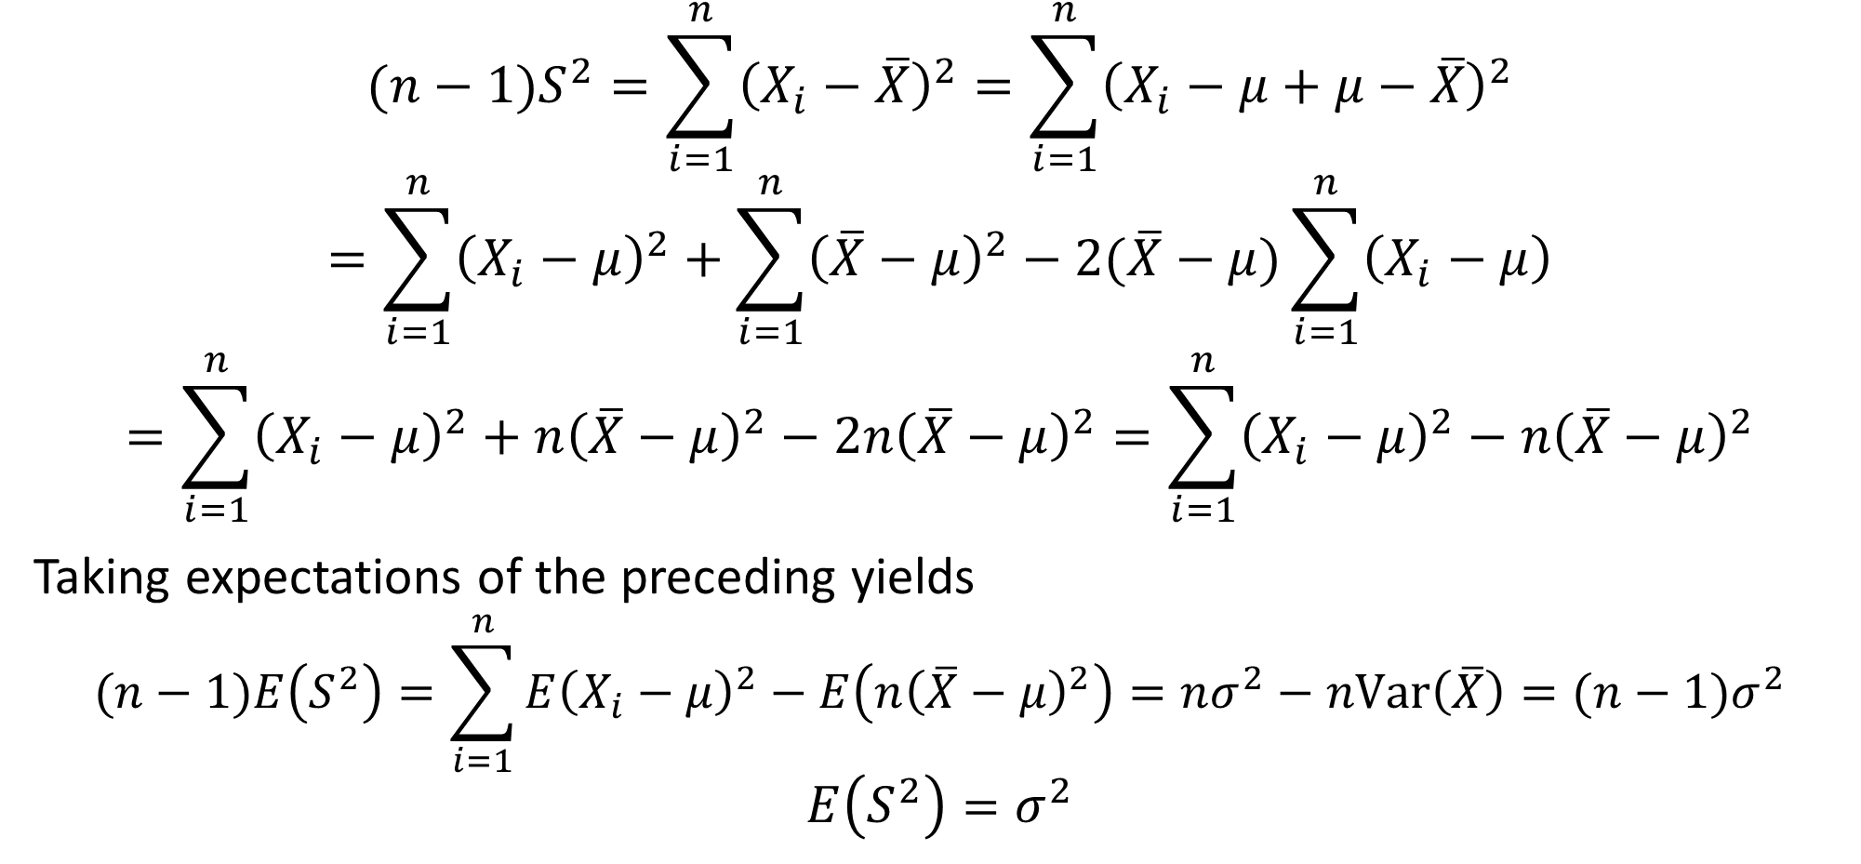
DLI
$$(n−1)S^{2}=\sum_{i=1}^{n}{{\left(X_{i}−\overline{X}\right)}^{2}}=\sum_{i=1}^{n}{{\left(X_{i}−μ+μ−\overline{X}\right)}^{2}}$$
$$=\sum_{i=1}^{n}{{\left(X_{i}−μ\right)}^{2}}+\sum_{i=1}^{n}{{\left(\overline{X}−μ\right)}^{2}}−2(\overline{X}−μ)\sum_{i=1}^{n}{\left(X_{i}−μ\right)}$$
$$=\sum_{i=1}^{n}{{\left(X_{i}−μ\right)}^{2}}+n{\left(\overline{X}−μ\right)}^{2}−2n{\left(\overline{X}−μ\right)}^{2}=\sum_{i=1}^{n}{{\left(X_{i}−μ\right)}^{2}}−n{\left(\overline{X}−μ\right)}^{2}$$
Taking expectations of the preceding yields
$$(n−1)E\left(S^{2}\right)=\sum_{i=1}^{n}{{E\left(X_{i}−μ\right)}^{2}}−E\left(n{\left(\overline{X}−μ\right)}^{2}\right)=nσ^{2}−nVar\left(\overline{X}\right)=(n−1)σ^{2}$$
$$E\left(S^{2}\right)=σ^{2}$$

Slide 25
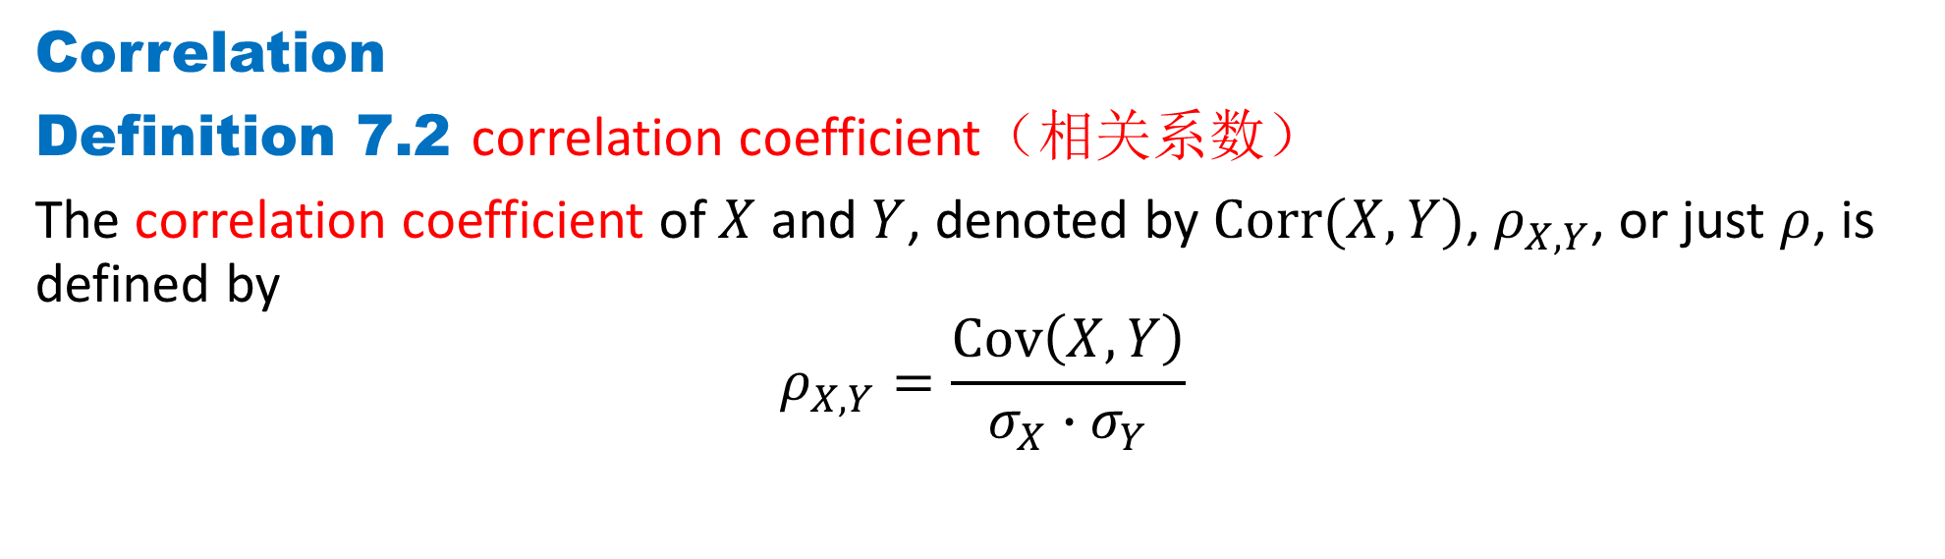
DLI
Correlation
Definition 7.2 correlation coefficient（相关系数）
The correlation coefficient of $X$ and $Y$, denoted by $Corr(X, Y)$, $ρ_{X,Y}$, or just $ρ$, is defined by
$$ρ_{X,Y}=\frac{Cov\left(X, Y\right)}{σ_{X}∙σ_{Y}}$$

Slide 26
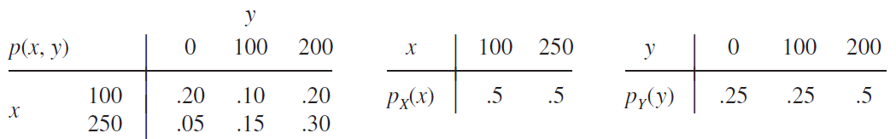
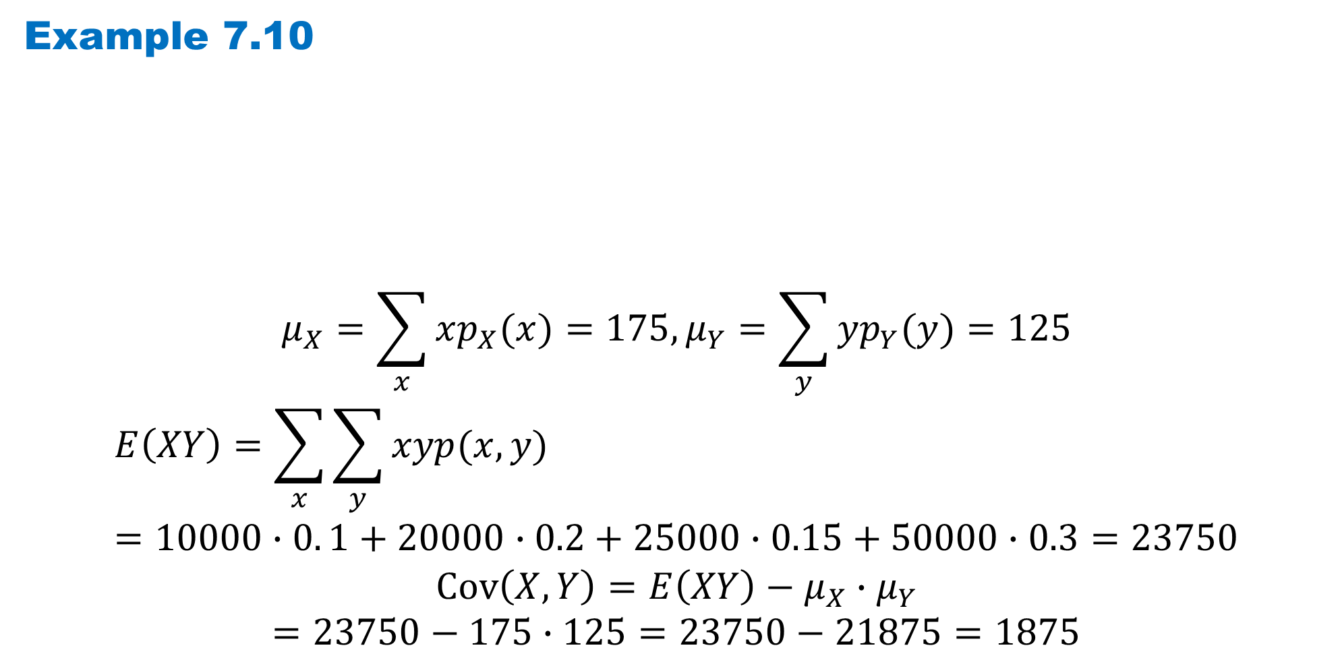
DLI
Example 7.10
$$μ_{X}=\sum_{x}{xp_{X}(x)}=175,μ_{Y}=\sum_{y}{yp_{Y}(y)}=125$$
$$E\left(XY\right)=\sum_{x}{\sum_{y}{xyp(x, y)}}=10000∙0. 1+20000∙0.2+25000∙0.15+50000∙0.3=23750$$
$$Cov\left(X, Y\right)=E\left(XY\right)−μ_{X}∙μ_{Y}$$
$$=23750−175∙125=23750−21875=1875$$

Slide 27
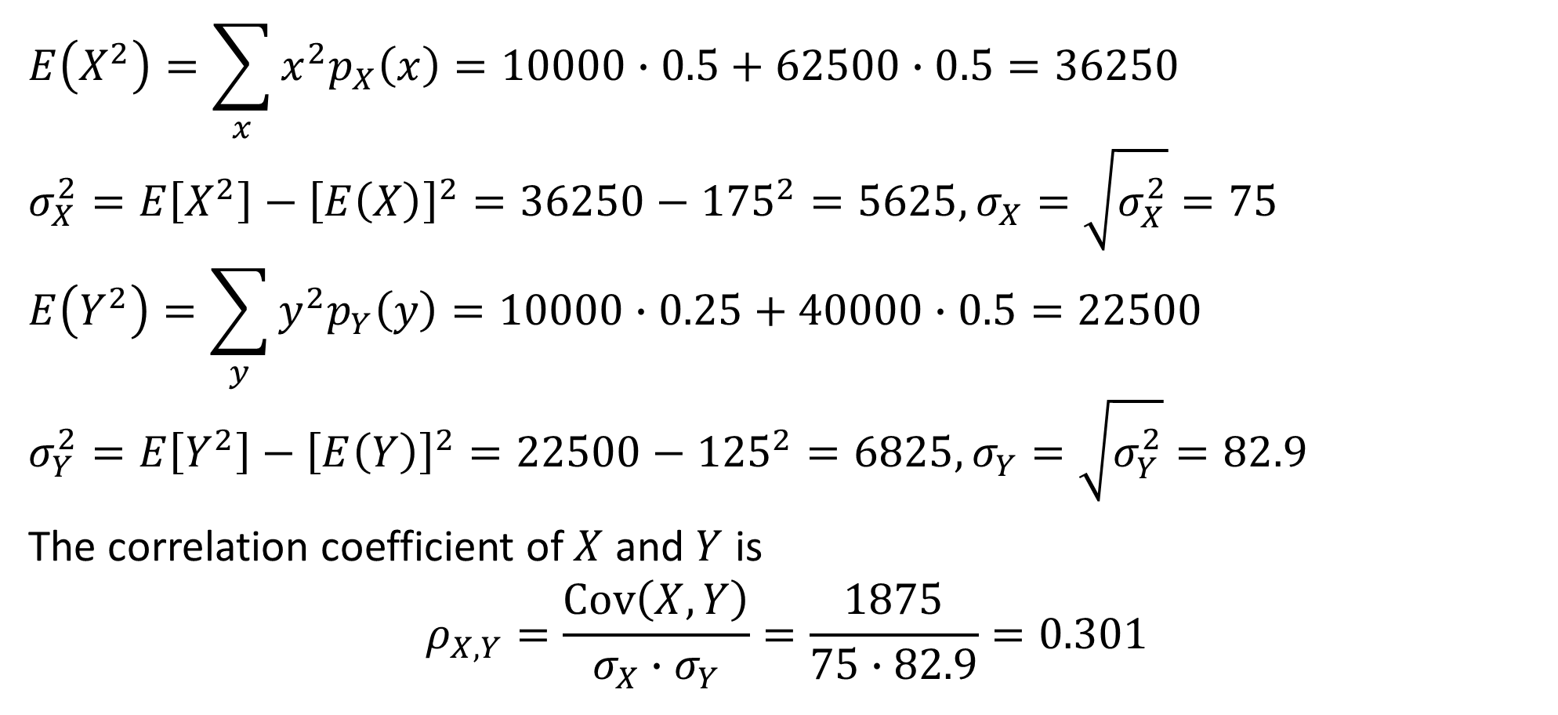
DLI
$$E\left(X^{2}\right)=\sum_{x}{x^{2}p_{X}\left(x\right)}=10000∙0.5+62500∙0.5=36250$$
$$σ_{X}^{2}=E\left[X^{2}\right]−{\left[E\left(X\right)\right]}^{2}=36250−{175}^{2}=5625, σ_{X}=\sqrt{σ_{X}^{2}}=75$$
$$E\left(Y^{2}\right)=\sum_{y}{y^{2}p_{Y}\left(y\right)}=10000∙0.25+40000∙0.5=22500$$
$$σ_{Y}^{2}=E\left[Y^{2}\right]−{\left[E\left(Y\right)\right]}^{2}=22500−{125}^{2}=6825, σ_{Y}=\sqrt{σ_{Y}^{2}}=82.9$$
The correlation coefficient of $X$ and $Y$ is
$$ρ_{X,Y}=\frac{Cov\left(X, Y\right)}{σ_{X}∙σ_{Y}}=\frac{1875}{75∙82.9}=0.301$$

Slide 28
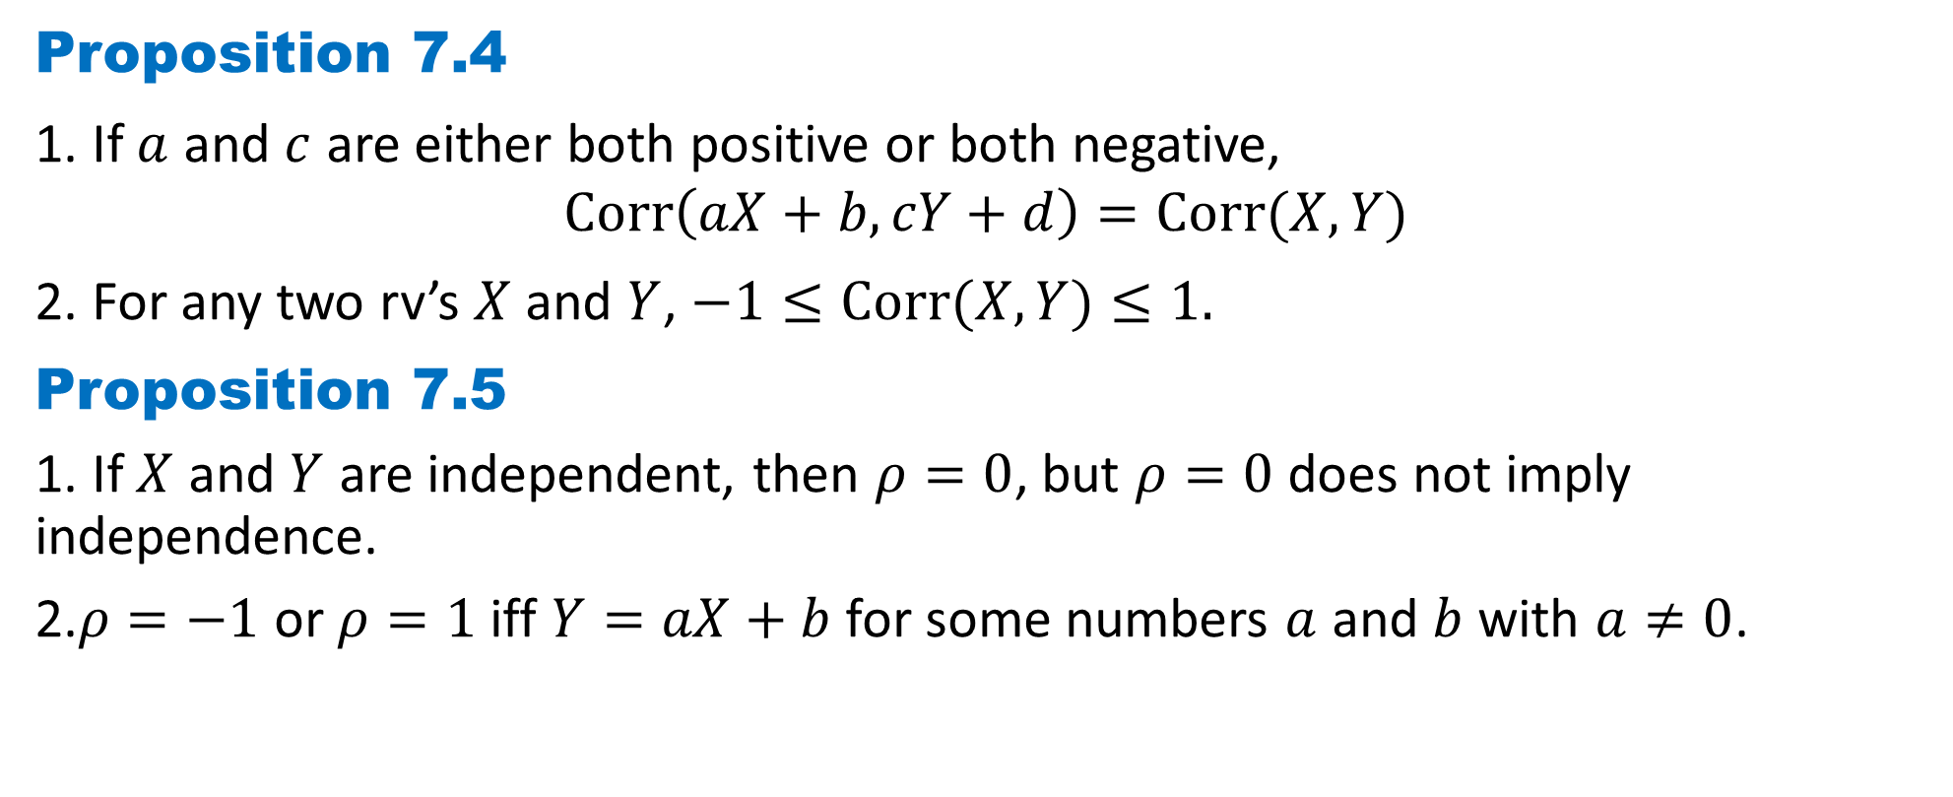
DLI
Proposition 7.4
1. If $a$ and $c$ are either both positive or both negative,
$$Corr\left(aX+b, cY+d\right)=Corr(X, Y)$$
2. For any two rv’s $X$ and $Y$, $−1≤Corr(X, Y)≤1.$
Proposition 7.5
1. If $X$ and $Y$ are independent, then $ρ=0$, but $ρ=0$ does not imply independence.
2.$ρ=−1$ or $ρ=1$ iff $Y=aX+b$for some numbers $a$ and $b$ with $a≠0$.

Slide 29
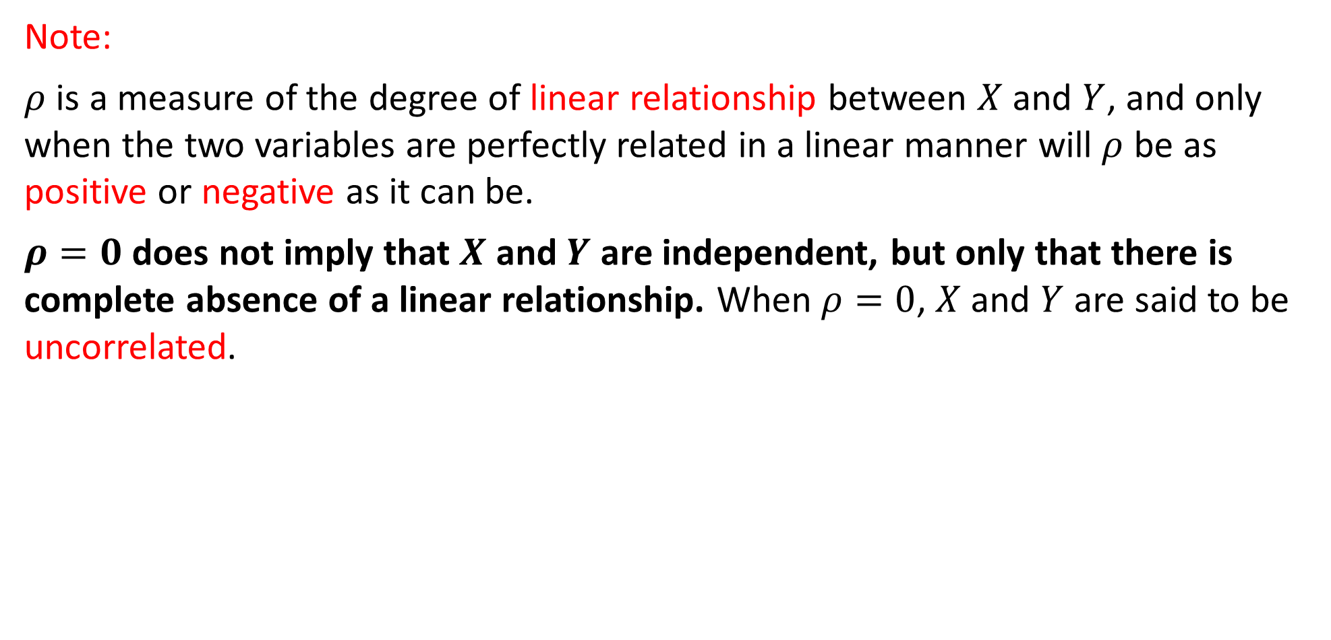
DLI
Note:
$ρ$ is a measure of the degree of linear relationship between $X$ and $Y$, and only when the two variables are perfectly related in a linear manner will $ρ$ be as positive or negative as it can be.
$ρ=0$ does not imply that $X$ and $Y$ are independent, but only that there is complete absence of a linear relationship. When $ρ=0$, $X$ and $Y$ are said to be uncorrelated.

Slide 30
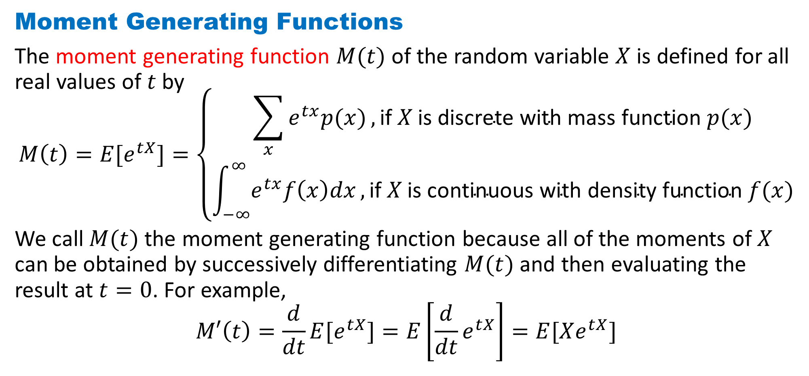
DLI
Moment Generating Functions
The moment generating function $M(t)$ of the random variable $X$ is defined for all real values of $t$ by
$$M\left(t\right)=E[e^{tX}]=\left\{\begin{aligned}\sum_{x}{e^{tx}p(x)},\text{if} X \text{is} \text{discrete} \text{with} \text{mass} \text{function} p(x) \\ \int_{−∞}^{∞}{e^{tx}f\left(x\right)dx},\text{if} X \text{is} \text{continuous} \text{with} \text{density} \text{function} f(x)\end{aligned}\right.$$
We call $M(t)$ the moment generating function because all of the moments of $X$ can be obtained by successively differentiating $M(t)$ and then evaluating the result at $t=0$. For example,
$$M′\left(t\right)=\frac{d}{dt}E[e^{tX}]=E\left[{\frac{d}{dt}e}^{tX}\right]=E[Xe^{tX}]$$

Slide 31
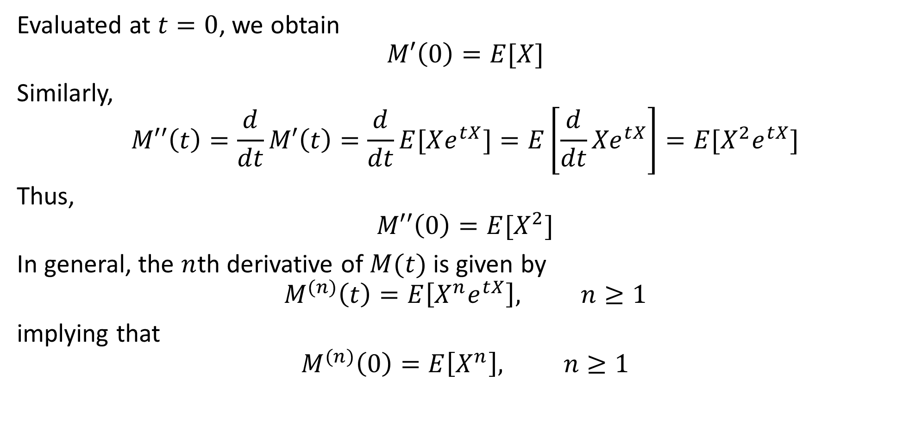
DLI
Evaluated at $t=0$, we obtain
$$M′\left(0\right)=E[X]$$
Similarly,
$$M′′\left(t\right)=\frac{d}{dt}M′\left(t\right)=\frac{d}{dt}E[Xe^{tX}]=E\left[{\frac{d}{dt}Xe}^{tX}\right]=E[X^{2}e^{tX}]$$
Thus,
$$M′′\left(0\right)=E[X^{2}]$$
In general, the $n$th derivative of $M(t)$ is given by
$$M^{(n)}\left(t\right)=E\left[X^{n}e^{tX}\right], n≥1$$
implying that
$$M^{(n)}\left(0\right)=E\left[X^{n}\right], n≥1$$

Slide 32
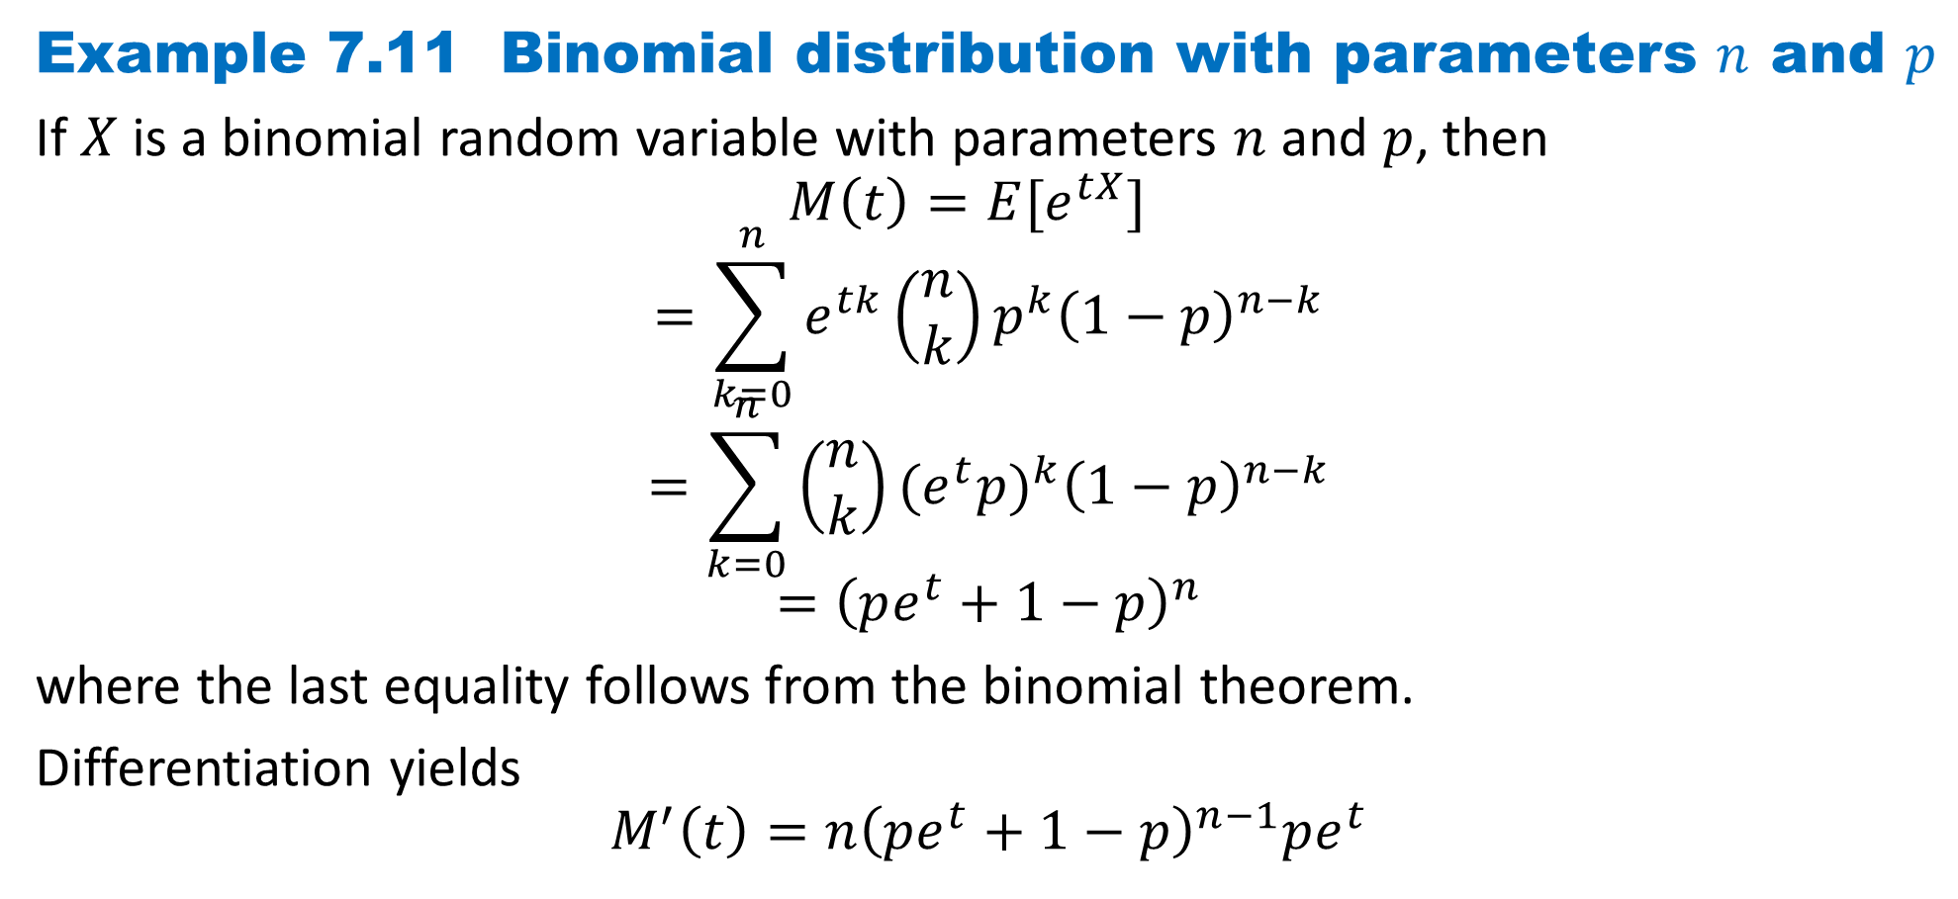
DLI
Example 7.11 Binomial distribution with parameters $n$ and $p$
If$X$ is a binomial random variable with parameters $n$ and $p$, then
$$M\left(t\right)=E[e^{tX}]$$
$$=\sum_{k=0}^{n}{e^{tk}\left(\begin{matrix}n \\ k\end{matrix}\right)p^{k}{\left(1−p\right)}^{n−k}}$$
$$=\sum_{k=0}^{n}{\left(\begin{matrix}n \\ k\end{matrix}\right){(e^{t}p)}^{k}{\left(1−p\right)}^{n−k}}$$
$$={\left(pe^{t}+1−p\right)}^{n}$$
where the last equality follows from the binomial theorem.
Differentiation yields
$$M^{′}\left(t\right)=n{\left(pe^{t}+1−p\right)}^{n−1}pe^{t}$$

Slide 33
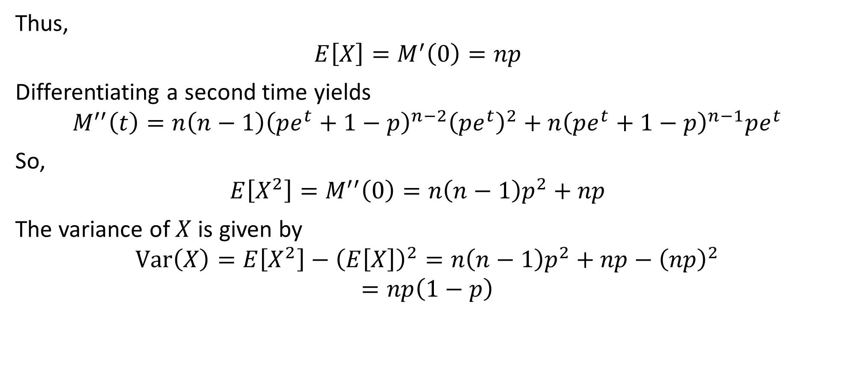
DLI
Thus,
$$E\left[X\right]=M^{′}\left(0\right)=np$$
Differentiating a second time yields
$$M^{′′}\left(t\right)=n\left(n−1\right){\left(pe^{t}+1−p\right)}^{n−2}{\left(pe^{t}\right)}^{2}+n{\left(pe^{t}+1−p\right)}^{n−1}pe^{t}$$
So,
$$E\left[X^{2}\right]=M^{′′}\left(0\right)=n\left(n−1\right)p^{2}+np$$
The variance of $X$is given by
$$Var\left(X\right)=E\left[X^{2}\right]−{\left(E\left[X\right]\right)}^{2}=n\left(n−1\right)p^{2}+np−{\left(np\right)}^{2}$$
$$=np\left(1−p\right)$$

Slide 34
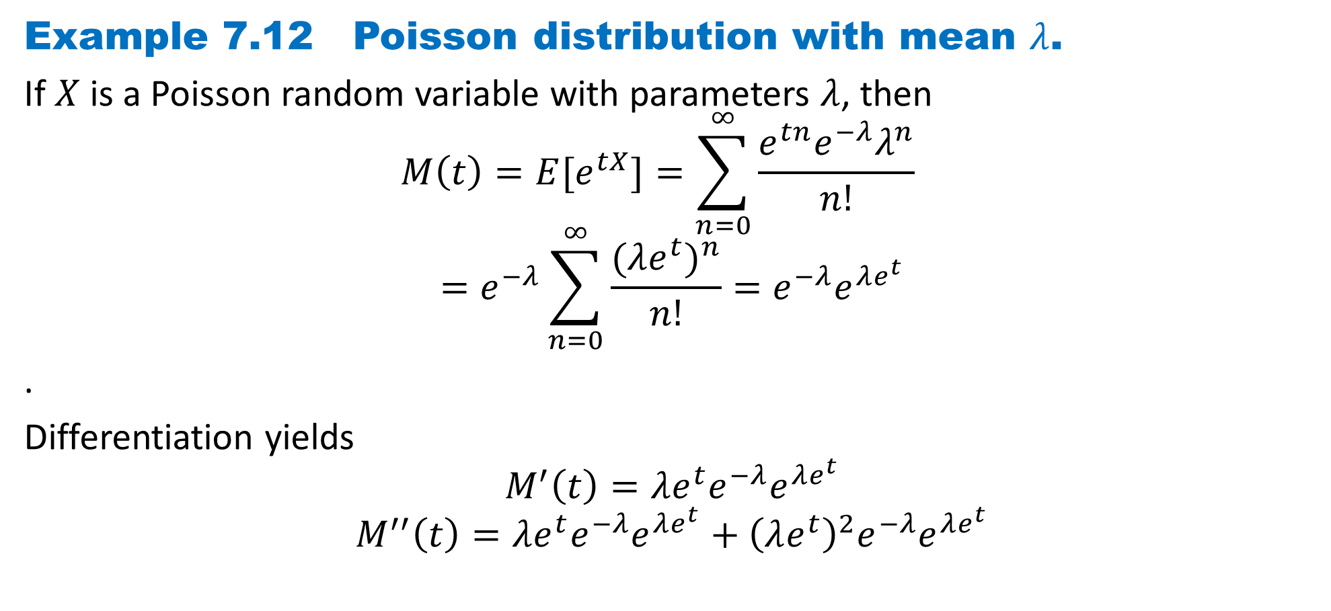
DLI
Example 7.12 Poisson distribution with mean $λ$.
If$X$ is a Poisson random variable with parameters $λ$, then
$$M\left(t\right)=E[e^{tX}]=\sum_{n=0}^{∞}{\frac{e^{tn}e^{−λ}λ^{n}}{n!}}$$
$$=e^{−λ}\sum_{n=0}^{∞}{\frac{({λe^{t})}^{n}}{n!}}=e^{−λ}e^{λe^{t}}$$
.
Differentiation yields
$$M^{′}\left(t\right)={λe^{t}e}^{−λ}e^{λe^{t}}$$
$$M^{′′}\left(t\right)={λe^{t}e}^{−λ}e^{λe^{t}}+{{\left(λe^{t}\right)}^{2}e}^{−λ}e^{λe^{t}}$$

Slide 35

DLI
Thus,
$$E\left[X\right]=M^{′}\left(0\right)=λ$$
$$E\left[X^{2}\right]=M^{′′}\left(0\right)={λ }^{2}+λ$$
The variance of $X$is given by
$$Var\left(X\right)=E\left[X^{2}\right]−{\left(E\left[X\right]\right)}^{2}={λ }^{2}+λ−{λ }^{2}=λ$$
Hence, both the mean and the variance of the Poisson random variable equal $λ$.

Slide 36
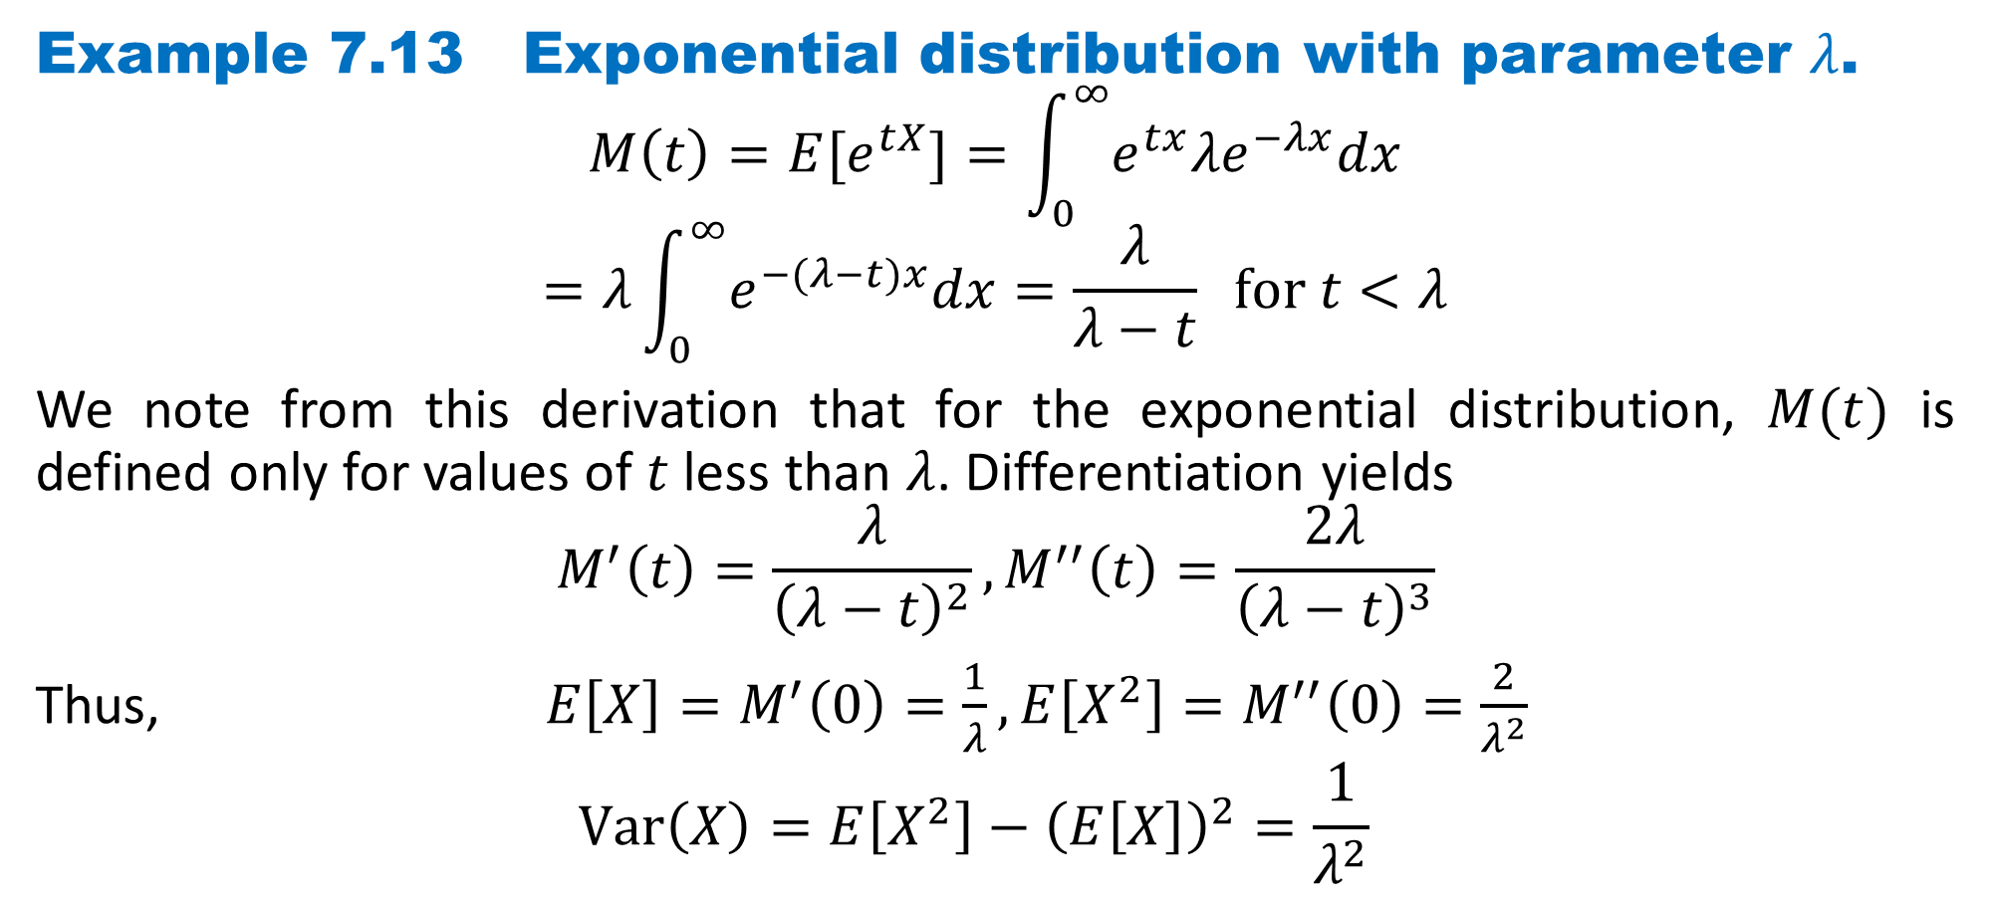
DLI
Example 7.13 Exponential distribution with parameter $λ$.
$$M\left(t\right)=E[e^{tX}]=\int_{0}^{∞}{e^{tx}{λe}^{−λx}dx}$$
$$=λ\int_{0}^{∞}{e^{−(λ−t)x}dx}=\frac{λ}{λ−t} for t<λ$$
We note from this derivation that for the exponential distribution, $M(t)$ is defined only for values of $t$ less than $λ$. Differentiation yields
$$M^{′}\left(t\right)=\frac{λ}{{\left(λ−t\right)}^{2}},M^{′′}\left(t\right)=\frac{2λ}{{\left(λ−t\right)}^{3}}$$
Thus, $E\left[X\right]=M^{′}\left(0\right)=\frac{1}{λ},E\left[X^{2}\right]=M^{′′}\left(0\right)=\frac{2}{λ^{2}}$
$$Var\left(X\right)=E\left[X^{2}\right]−{\left(E\left[X\right]\right)}^{2}=\frac{1}{λ^{2}}$$

Slide 37
DLI
Homework
Page 375 Problems
1, 4, 6, 30, 33, 40
Page 382 Theoretical Exercises
1, 19, 22
Page 386 Self-Test Problems and Exercises
32

